Slide 1

“Design and Analysis of Multithreaded Parallel Dual Population Genetic Algorithm (MPDPGA) on Multicore System for Function Optimization”
Broad Area: Soft computing
Specific area: Evolutionary algorithms
By
A. J. Umbarkar
[Registration: 2010]
Guide
Dr. Mrs. Madhuri S. Joshi, Govt. College of Engineering, Aurangabad.
and
Professor, Department of Computer Engineering,
Jawaharlal Nehru Engineering College,
Aurangabad.
Dr. Babasaheb Ambedkar Marathwada University,
Aurangabad- 431 004

Slide 2
Outline
History of GA
Other metaheuristics
Literature Survey
Need/Gap
History of DPGA
Problem Definition
Objectives of Proposed Work
Comparison with other Works
Validation
Proposed Algorithms at Glance
Publications
Conclusion
Novelties/contribution
Future scope
References

Slide 3
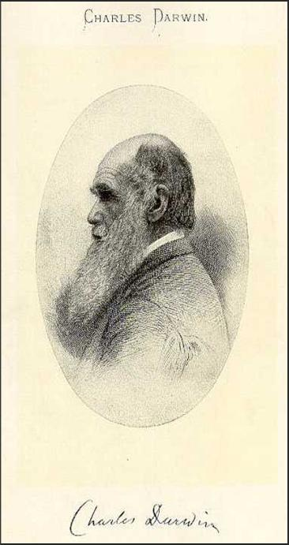
History of GA
Genetic Algorithms (GAs) were invented by John Holland and developed by him and his students and colleagues at the University of Michigan in 1975.
For classification of optimization techniques and GA in detail

Slide 4
Other Metaheuristics
Artificial Immune Algorithms (AIAs) [21],
Ant Colony Optimization (ACO) [22],
Particle Swarm Optimization (PSO) [23],
Artificial Neural Network (ANN) [24],
Differential Evolution (DE) [25],
Harmony Search (HS) [26],
Bacteria Foraging Optimization (BFO) [27],
Shuffled Frog Leaping (SFL) [28],
Artificial Bee Colony (ABC) [29],
Biogeography-Based Optimization (BBO) [30],
Gravitational Search Algorithm (GSA) [31],
Grenade Explosion Method (GEM) [32],
Cuckoo Search (CS) [33],
Fire Fly algorithm (FFA) [34],
Mine Blast algorithm (MBA) [35] and
Teaching–learning-based optimization (TLBO) [36].

Slide 5
Literature Review* GAs, Microprocessors, Computing Technologies & languages
GAs (Year) | Microprocessor/ core | Computing Technology | Languages (Year)
SGA (1989): simple genetic algorithm: better exploration SSGA: Steady state GA: better exploration for solution in population. MGA (1989 ): Messy GA by Golgberg, Deb, Krob (adaptive GA) Binary coded GA Real coded GA BGA (1993) : Breeder Genetic Algorithm by Miihleiibein & Voosen CCGA :(Co-operative Co evaluation) by De Jong (1994) Tested on Multimodal test function SOGA: Single Objective GA. dGA (1994): dual (diploid ) GA : dual chromosome based approach. MGA/MPGA (2000): Multi-population GAs HGAs (2000):Hierarchical Genetic Algorithms MOGA (2000) : multi Objective GA by Gao, Shi & Yao. SNSGA: Steady state NSGA: by Deb NSGA-II (2002): Non-dominated sorting GA by Deb PGA (2002):Parallel GA by Gibson , Burger & Knox. MGA [2002]:Multi-population GA PDGA (2003): primal dual GA DPGA [2007]:Dual population GA/DPGA-ED/DPGA2 by T. Park DSGA (2008) :Dual Species GA DPGA (2011) (with adaptive diversity control) | Intel 80386 Intel 80486/AMD AM386 Pentium (P-I) Pentium (P-II/III)/AMD Athlon Pentium (PIV)/AMD Celeron Intel Core 2 Duo 2009 onward dual/quad…. | SISD SIMD MIMD :Flynn’s taxonomy Shared or distributed memory machine (loosely/tightly) Master slave Grid computing Cloud computing Cluster computing CPU:GPGPU (Nvidia) Multicore: Dual core, Quad Core, HPC…… | FortranV(1978) , Pascal (1970), C(1978), Cobol (1961), C++ (1983) VB 1.0 (1993) Python, C#, Java 2.0, PHP 4.0, Perl 5.6, VB.Net (2000) Parallel programming libraries/tool like OpenMP and MPI/CUDA/Matlab..
Enrique Alba and Marco Tomassini, “Parallelism and Evolutionary Algorithms”, IEEE TRANSACTIONS ON EVOLUTIONARY COMPUTATION, VOL. 6, NO. 5, OCTOBER 2002. *Details of literature review is in publication of ICTACT Journal and Springer conference paper

Slide 6
Need/Gap
Speedup on Multicore system (System resource utilization)
Parallel DPGA algorithm
Global optimization algorithm
Problems in GA
Premature convergence (local Optima)
Population diversity

Slide 7
History of DPGA
Idea of reserve population in GA with the objective as population diversity was introduced in 2006 by T. Park et al [150].

Slide 8
Problem Definition
“The goal is to design and analyze the parallel Multi population Genetic Algorithm (MPGA) on multicore system and apply it to optimize the performance of unimodal and multimodal test functions (Function Optimization).”

Slide 9
objectives of proposed work
To design and implement multithreaded Parallel Dual Population GA (MPDPGA) on a multicore System.
To implement Simple Genetic Algorithm (SGA), Serial DPGA (SDPGA) on Multicore System and compare its performance with the proposed PDPGA.
To seek the parallelism amongst populations of DPGA using threading.
To check the performance analysis of MPDPGA with SGA and SDPGA on multicore System.
To explore and exploit the search space and provide population diversity, and to examine its effect on premature convergence through the reserve population.

Slide 10
COMPARISON with other works
Compared with other eight natured-inspired optimization methods:
Genetic Algorithm (GA), Particle Swarm Optimization (PSO), Differential Evolution (DE), ANTS, Bee Colony, Grenade Explosion Method (GEM) and Bee Colony Optimization (BCO), Artificial Bee Colony (ABC) and Teaching–learning-based optimization TLBO.
Compared with diversity based seven metaheurestics: DPGA, Island Model GA (IMGA), Restricted Tournament Selection (RTS) and Standard GA (StGA), Classical Evolutionary Programming (CEP), Adaptive EP with Lévy Mutation (ALEP) and Diversity Guided Evolutionary Algorithm (DGEP).
K.S.F.Shu and Z. Erwie, "Hybrid simplex search and PSO for unconstrained optimization", European Journal of Operation research, 181, pp. 527-548, 2007.
D. Karaboga and B. Akay, "ABC for large scale problem and engineering design optimization", Applied mathematics and computation, Elsevier-214, pp. 108-132, 2009.
A. Ahrari and A. A. Atai, "Granade explosion Method- A novel tool optimizations", Applied soft computing 10, Elsevier, pp, 1132-1140, 2010.
R.V. Rao, V.J. Savsani and D.P. Vakharia, "Teaching Learning Based optimization: An Optimization Method for continuous nonlinear large scale problem", Information science, Elsevier, pp. 1-15, 2012.
M. Nikoloc and D. Teodorovic,"Empirical study of the Bee Colony Optimization Algorithm (BCO) ", Expert system and application, 40, Elsevier, pp. 4609-4620, 2013.
M.S. Alama, M. M. Islama, X. Yaob and K. Murased, “Diversity Guided Evolutionary Programming: A novel approach for continuous optimization", Applied soft computing, 12, Elseiver, pp. 1693- 1707, 2012.
T. Park and K. R. Ryu, “A Dual-Population Genetic Algorithm for Adaptive diversity control”, IEEE Transactions on Evolutionary Computation, pp. 865–884, 2010.
T. Park and K. R. Ryu. “A dual population genetic algorithm with evolving diversity”, In IEEE Congress on Evolutionary Computation (CEC2007), pp. 3516–3522, 2007.

Slide 11
VALIDATION
Statiscal analysis and tests: Mean, Standard Deviation, Standard Error of Mean, t-Test, Success Rate, Mean Function Evaluation and Function Evaluation for Best Solution
Profiling software: Java visual VM –CPU utilization, Memory unitization, etc.
Performance Parameters : Reliability (success rate), efficacy (mean, standard deviation and standard error of mean) and efficiency (function evaluation)

Slide 12
Proposed algorithms at glance
Introduction to DPGA
Fitness function for reserve population
Serial version of Algorithm: Serial DPGA
Parallel Version of Algorithm: MPDPGA = PDPGA
Parallel MPMRPGA
Thread Synchronization diagram for MPDPGA with one reserve population
MPMRPGA with M_{P} thread and multiple R_{P} threads generalization
Thread Synchronization diagram for MPMRPGA with waiting M_{P} for every R_{P}
Thread Synchronization diagram for MPMRPGA with M_{P} crossbreeds with multiple R_{P} one at time

Slide 13
Introduction :DUAL population GA (DPGA) [58]
A single population genetic algorithm is powerful, but better results can be obtained by introducing two or many populations
Every reserve population evolves search space.
The DPGA algorithm has two distinct populations
Main Population (CEC 2005, collection with properties)
Reserve Population(s)
Algorithm performs inbreeding, crossbreeding and survival selection.
One or more individuals are exchanged from the reserve populations and main – population for providing the diversity.
Every populations have different evolutionary objectives

Slide 14
Fitness function for reserve population (R_{p})
T.Parks proposed fitness function
[150, 151, 152 and155]
Our proposed fitness function
Bitwise subtraction :
Where,
n : size of main population
m_{i} : i^{th} chromosome of main population
hd(m_{i} ,x) : Hamming dist between m_{i} , x
l : length of chromosome
m_{i,k} : k^{th} gene of chromosome m_{i}
x_{k} : k^{th} gene of given chromosome x
Bitwise EXOR:
Where,
EXOR
Bitwise EXOR function gives better results (in terms of no of evaluations and execution time) than bitwise subtraction

Slide 15
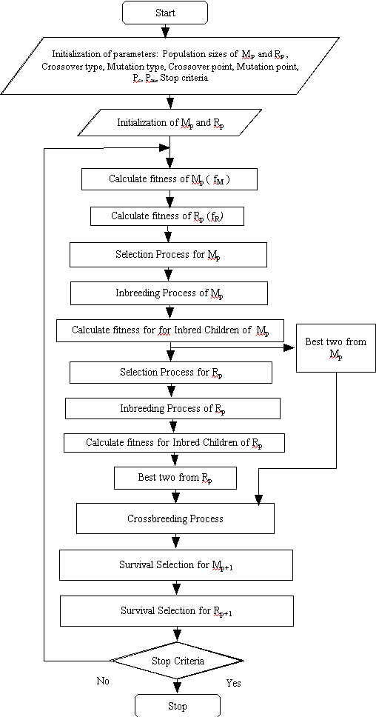
Single threaded SDPGA

Slide 16
MPDPGA
(Reserve Population =1)

Slide 17
Thread Synchronization diagram for MPDPGA
with one reserve population
Crossbreeding between M_{P} with R_{P} provides diversity to main population in MPDPGA

Slide 18
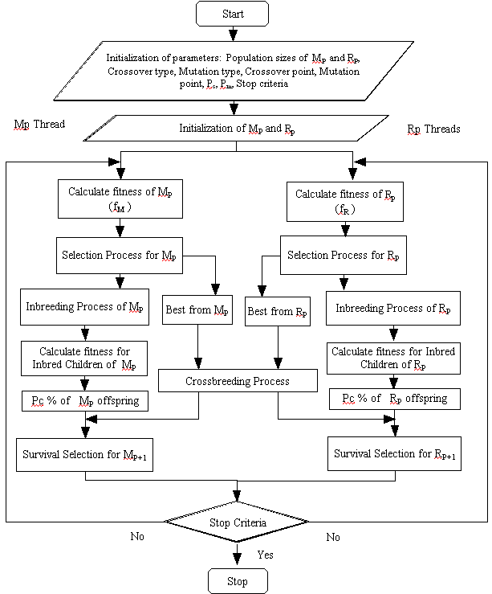
MPMRPGA

Slide 19
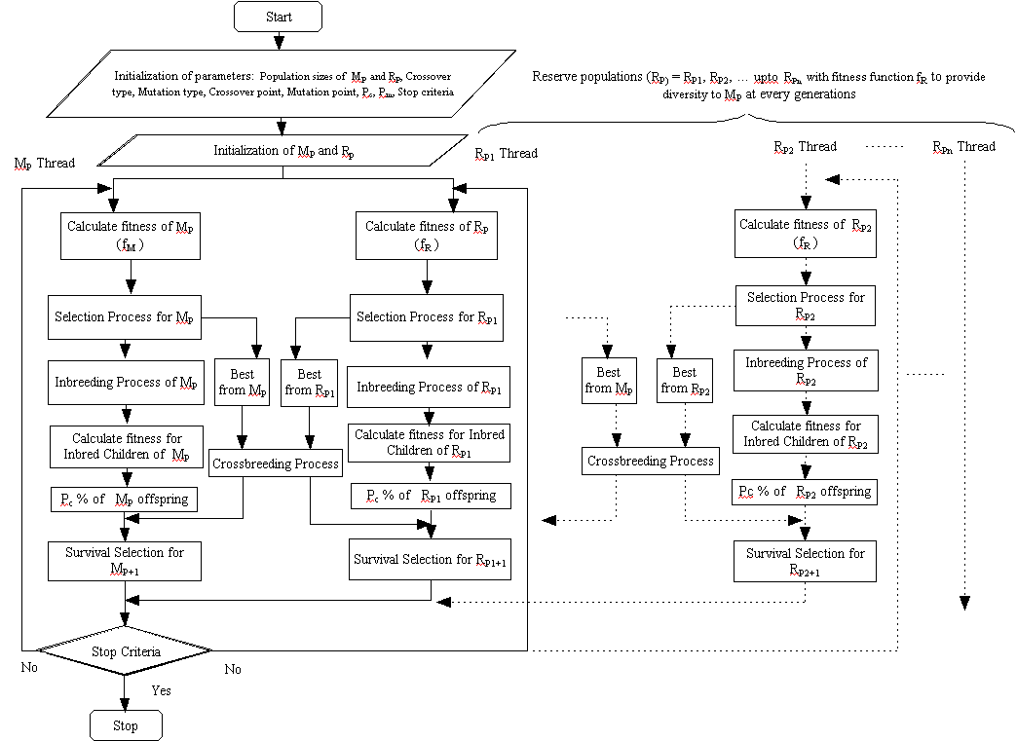
MPMRPGA with M_{P} thread and multiple R_{P} threads generalization

Slide 20
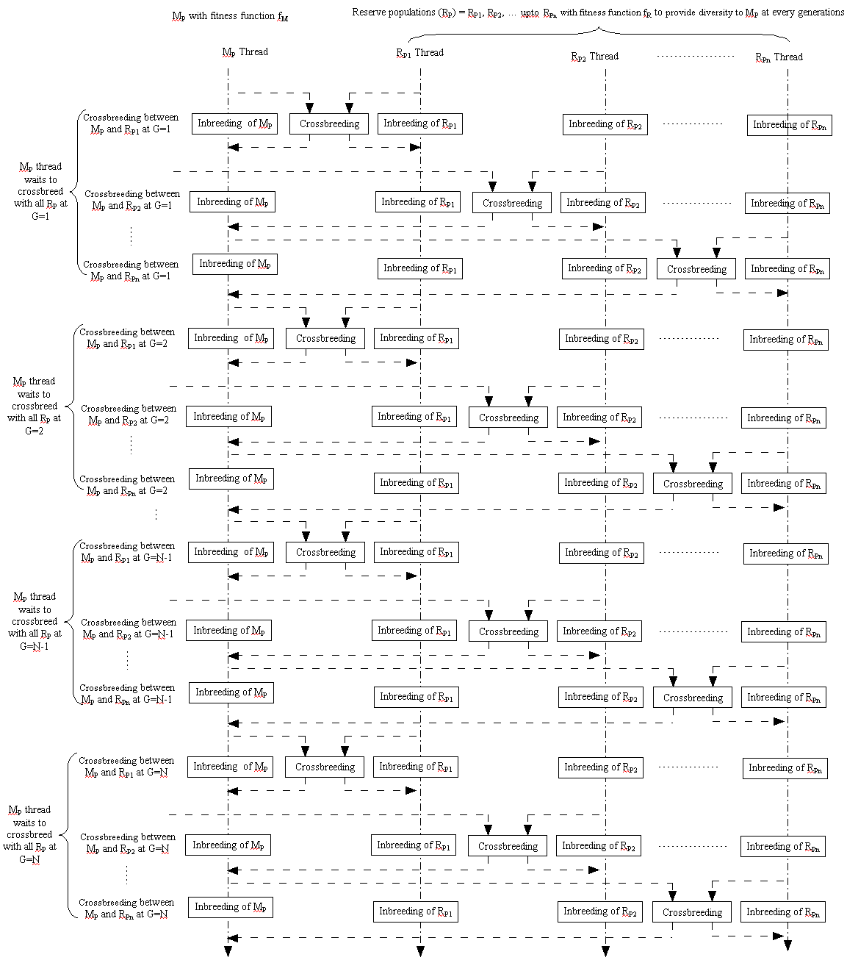
Thread Synchronization diagram for MPMRPGA with waiting M_{P} for every R_{P}

Slide 21
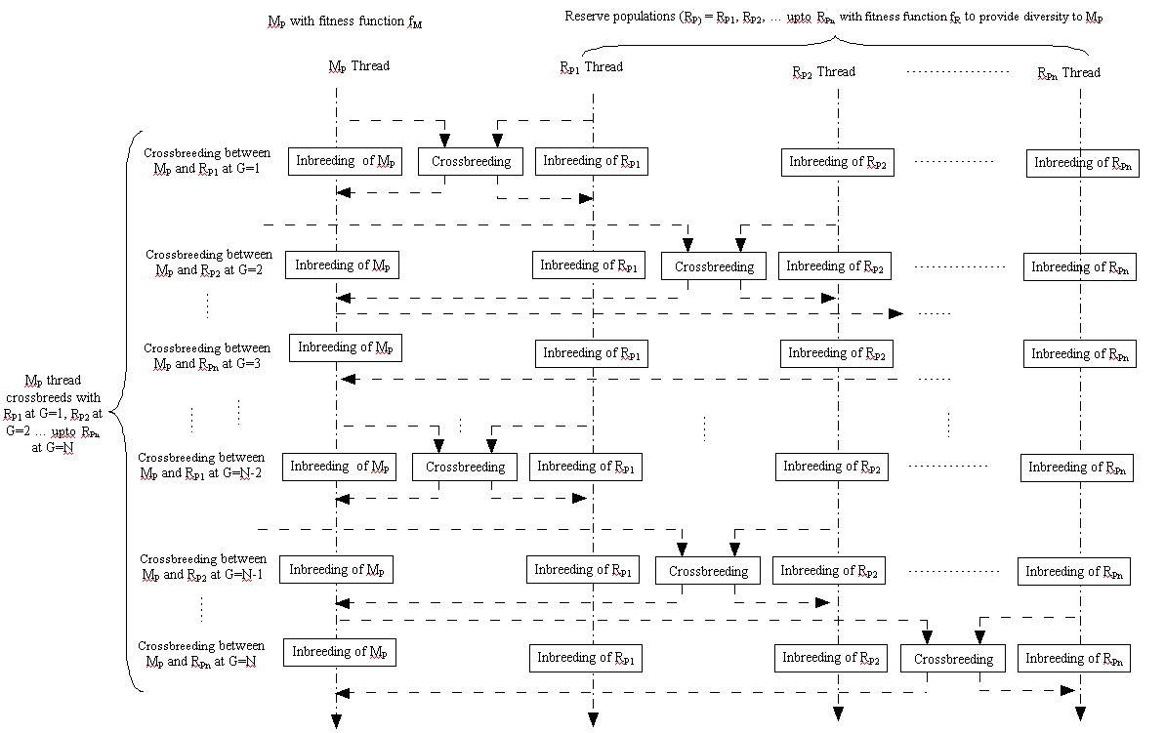
Thread Synchronization diagram for MPMRPGA with M_{P} crossbreeds with multiple R_{P} one at a time

Slide 22
MPDPGA, SDPGA, SGA and profiling

Slide 23









Standard test functions considered
Function Name | Function | Range | F(x)
De-jong (F1) |  | [-5.12, 5.12] | 0
Axis parallel hyper-ellipsoid (F2) |  | [-5.12, 5.12] | 0
Rotated hyper-ellipsoid (F3) |  | [-65.536, 65.536] | 0
Sum of different power (F4) |  | [-1, 1] | 0
Rastrigin (F5) |  | [ -5.12, 5.12] | 0
Rosenbrock (F6) |  | [-2.048, 2.048] | 0
Schwefel 2.26 (F7) |  | [-500, 500] | -418.9829
Griewangk (F8) |  | [-600, 600] | 0
Ackley (F9) |  | [-32.768, 32.768] | 0

Slide 24
Parameter setting for SGA, SDPGA and MPDPGA
Operator/parameter | DPGA –ED^{k} | MPDPGA | SDPGA | SGA
Initialization | Random | Random | Random | Random
Main Population size ( M_{P}) | 50 | 50 | 50 | 100
Reserve Population size (R_{P}) | 10 | 50 | 50 | --
Selection | Tournament | Tournament | Tournament | Tournament
Crossover type | Two-point | K-point | K-point | K-point
Crossover point K | 2 | 5 | 5 | 5
Mutation type | Bitwise | Flip bit | Flip bit | Flip bit
Crossover rate | 0.70 | 0.70 | 0.70 | 0.70
Mutation rate | 1 / l | 0.01 | 0.01 | 0.01
Crossbreeding rate | Not given | 0.04 | 0.04 | Not applicable
Elitism | Not given | 0.25 | 0.25 | 0.29
Distance measure | Hamming | Hamming | Hamming | Not applicable
Diversity Control | Adaptive Crossbreeding | Fixed Crossbreeding | Fixed Crossbreeding | Not applicable
Stopping criteria | Generation | Generation or Optimal solution | Generation or Optimal solution | Generation or Optimal solution

Slide 25
Comparison of Best Solution Found in SGA, SDPGA & MPDPGA for f1-f4
Test function (F) | Algorithm | Best Solution Found | No. of Generations
f1 | MPDPGA | 0 | 387
 | SDPGA | 0.05819786 | 1,15,307
 | SGA | 0.07285063 | 2,00,063
f2 | MPDPGA | 0 | 705
 | SDPGA | 0.011136 | 1,75,390
 | SGA | 0.07028506 | 2,95,963
f3 | MPDPGA | 0 | 1,545
 | SDPGA | 0.09243455 | 1,78,898
 | SGA | 0.45661236 | 2,12,112
f4 | MPDPGA | 0 | 789
 | SDPGA | 0.00160071 | 79,588
 | SGA | 0.02400132 | 1,15,478

Slide 26
Comparison of Best Solution Found in SGA, SDPGA, MPDPGA with DPGA-Ed^{k} for f5-f9
Test function (F) | Algorithm | Best Solution Found | No. of Generations
f5 | MPDPGA | 0 | 33,782
 | SDPGA | 0.07933123 | 35,712
 | SGA | 075981456 | 80,125
 | DPGA-ED^{k} | 0 | 34,934
f6 | MPDPGA | 0.00612658 | 1,002
 | SDPGA | 0.48340664 | 33,139
 | SGA | 0.94597337 | 1,54,462
 | DPGA-ED^{k} | 0.9921 | 5,00,000
f7 | MPDPGA | 0.004589554 | 2,053
 | SDPGA | 0.00232797 | 1,23,549
 | SGA | -0.07381499 | 1,57,294
 | DPGA-ED^{k} | 0.0014 | 89,007
f8 | MPDPGA | 0.15830217 | 1,500
 | SDPGA | 0.12492430 | 3,96,121
 | SGA | 0.32442724 | 4,01,512
 | DPGA-ED^{k} | 0.0680 | 483255
f9 | MPDPGA | 0.49586544 | 1,705
 | SDPGA | 0.49528813 | 22,035
 | SGA | 0.49930387 | 60,676
 | DPGA-ED^{k} | 0 | 16,081
K. DPGA and DPGA-ED are work of Park & Ryu, 2007 [150]

Slide 27
Best Solution Found in SGA, SDPGA and MPDPGA with DPGA^{k}, DPGA-Edk for f5-f9
Test function (F) | Algorithm | MPDPGA Versus | DPGA^{k} Versus | DPGA-ED^{k}Versus
F5 | MPDPGA | --- | + | ≈
 | SDPGA | + | ≈ | -
 | SGA | + | - | -
F6 | MPDPGA | --- | + | +
 | SDPGA | - | + | +
 | SGA | - | + | ≈
F7 | MPDPGA | --- | + | ≈
 | SDPGA | ≈ | + | +
 | SGA | + | + | -
F8 | MPDPGA | --- | - | -
 | SDPGA | ≈ | - | -
 | SGA | + | - | -
F9 | MPDPGA | --- | ≈ | -
 | SDPGA | ≈ | ≈ | -
 | SGA | ≈ | - | -
k. DPGA and DPGA-ED are work of Park & Ryu, 2007 [150]

Slide 28
Comparison of MFE and SR
F | Algorithm | MFE | SR %
f1 | MPDPGA | 35650 | 100
 | SDPGA | 969250 | 70
 | SGA | 6556450 | 0
f2 | MPDPGA | 18900 | 100
 | SDPGA | 1341950 | 100
 | SGA | 11130850 | 0
f3 | MPDPGA | 285450 | 100
 | SDPGA | 2681950 | 100
 | SGA | 7856700 | 100
f4 | MPDPGA | 44850 | 100
 | SDPGA | 846150 | 60
 | SGA | 6512700 | 60
f5 | MPDPGA | 257500 | 100
 | SDPGA | 939350 | 90
 | SGA | 2343450 | 20
f6 | MPDPGA | 327300 | 100
 | SDPGA | 13016100 | 40
 | SGA | 13284600 | 30
f7 | MPDPGA | 287950 | 100
 | SDPGA | 330100 | 0
 | SGA | -- | --
f8 | MPDPGA | 197450 | 100
 | SDPGA | 259050 | 0
 | SGA | 5164400 | 0
f9 | MPDPGA | 221400 | 100
 | SDPGA | 1568600 | 20
 | SGA | 5164400 | 10

Slide 29
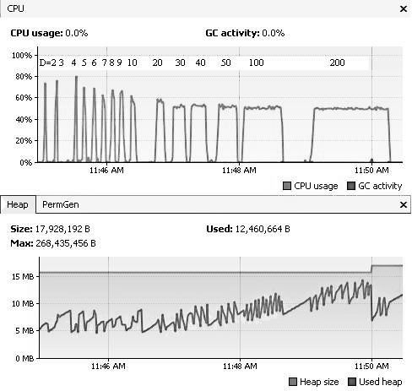
CPU usage, Heap usage to complete G=500 with varying D for f6 on SDPGA

Slide 30
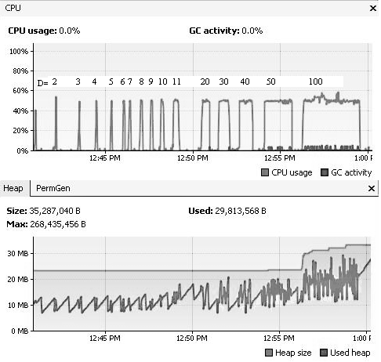
CPU usage, Heap usage to complete G=500 with varying D for f6 on MPDPGA

Slide 31
Comparison of Solution found, Average CPU usage and Time required to complete G=100 with varying D for f₆ on SDPGA and MPDPGA
Dimension (D) | Algorithm | Solution Found F(x) | Average CPU usage (%) | Time (ms)
2 | SDPGA | 0.0404656 | 72 | 969
 | MPDPGA | 0.0028137 | 50 | 15,734
3 | SDPGA | 0.4754566 | 75 | 1,391
 | MPDPGA | 0.1223543 | 49 | 46,547
4 | SDPGA | 4.2545643 | 80 | 1,719
 | MPDPGA | 0.344632 | 51 | 52,567
5 | SDPGA | 18.037535 | 70 | 2,265
 | MPDPGA | 2.755012 | 50 | 58,282
6 | SDPGA | 90.902155 | 68 | 2,515
 | MPDPGA | 5.644869 | 51 | 84,078
7 | SDPGA | 42.164541 | 63 | 2,890
 | MPDPGA | 5.894460 | 51 | 1,06,297
8 | SDPGA | 137.30311 | 59 | 3,250
 | MPDPGA | 12.65166 | 51 | 1,20,704
9 | SDPGA | 549.15165 | 58 | 3,531
 | MPDPGA | 9.30721 | 50 | 1,28,432
10 | SDPGA | 235.5564 | 62 | 3,922
 | MPDPGA | 6.88576 | 51 | 1,33,563
20 | SDPGA | 896.5251 | 58 | 7,438
 | MPDPGA | 15.2168 | 50 | 2,45,333
30 | SDPGA | 1371.520 | 52 | 10,750
 | MPDPGA | 136.2258 | 49 | 5,34,900
40 | SDPGA | 2385.52 | 53 | 14,328
 | MPDPGA | 175.22 | 51 | 11,67,908
50 | SDPGA | 3979.12 | 52 | 15,965
 | MPDPGA | 302.853 | 51 | 24,89,901
100 | SDPGA | 5145.36 | 51 | 27,454
 | MPDPGA | 900.565 | 50 | 50,23,489

Slide 32
Solution found F(x) versus Generation G on SGA, SDPGA and MPDPGA for f6

Slide 33
Solution found F(x) versus Generation G up to 100 on SGA, SDPGA and MPDPGA for f6

Slide 34
CPU usages versus Dimension D for G up to 100 on SDPGA and MPDPGA for f6

Slide 35
Discussions of MPDPGA, SDPGA and SGA for above results
DPGA is algorithmically parallel and performs better than SDPGA and SGA
MPDPGA significantly better over SDPGA and SGA in terms of convergence and population diversity.
The CPU utilization is optimized and almost stable (~50%) in MPDPGA for said configuration. (Springer SOCOPROS 11)

Slide 36
DPGA versus OpenMP GA, SGA
Serial implemented DPGA is compared with OpenMP GA.
SDPGA is single threaded implemented in Java and OpenMP GA is implemented in C with Parallel Programming Library called OpenMP

Slide 37





Standard test SET considered
Function Name | Equation | Range | Optimum value
Rosenbrock (F1) |  | [-2.048 ,2.048] | 0
Ackley (F2) |  | [-32.768 ,32.768] | 0
Griewangk (F3) |  | [-600 ,600] | 0
Schwefel (F4) |  | [-500 ,500] | -418.9829
Rastrigin (F5) |  | [-5.12 ,5.12] | 0

Slide 38
Best Solution found and Execution Time for multimodal test functions
Test function | Best Solution Found for SGA | Best Solution Found for OpenMP GA | Best Solution Found for DPGA | Time (sec) taken by SGA | Time (sec) taken by OpenMP GA | Time (sec) taken by DPGA
F1 | 2.47E+00 | 4.79E+00 | 1.03E+00 | 11.38 | 4.32 | 3.45
F2 | 1.38E-02 | 2.55E-03 | 1.30E-03 | 11.76 | 10.59 | 10.04
F3 | 1.08E+00 | 3.25E+00 | 3.23E+00 | 10.75 | 4.61 | 3.65
F4 | -1.91E+03 | -1.83E+03 | -1.82E+03 | 10.29 | 3.94 | 3.02
F5 | 5.18E-02 | 9.83E-01 | 4.96E-02 | 22.32 | 10.65 | 10

Slide 39

Speed up gained for multimodal functions in comparison with SGA and OpenMP GA
Test Function | Speed up of DPGA compared with OpenMP GA (%) | Speed up of DPGA compared with SGA (%)
F1 | 20.13 | 69.58
F2 | 05.20 | 14.62
F3 | 20.82 | 66.04
F4 | 23.35 | 70.65
F5 | 15.12 | 55.20

Slide 40
Best solutions found by DPGA, OpenMP GA and SGA on multimodal test functions F1, F2, F3 and F5
Best solutions found by DPGA, OpenMP GA and SGA on multimodal test functions F4

Slide 41
Speed up gained in DPGA over OpenMP GA and SGA for multimodal test functions

Slide 42
Time (in seconds) comparison for SGA, OpenMP GA & DPGA to find BSF for multimodal test functions
Execution Time (Sec)
Test function

Slide 43
Discussions of Serial DPGA verse OpenMp GA comparison
The multimodal functions take less time on DPGA than OpenMP GA and SGA to get the best solution.
The quality of solution shown by DPGA is better as compare to SGA and OpenMP GA except F3 for given generation.
The Speed up achieved by DPGA in comparison with SGA and OpenMP GA is remarkable. The average speed up shown by DPGA over SGA is ~55 % and over OpenMP GA is 15%.
The niching technique used in DPGA gives better result than parallel GA.
The algorithmic design is more important than only parallel implementation.
(IJCA )

Slide 44
Statistical analysis of MPDPGA algorithm

Slide 45
No free Lunch (NFL) Theorem
16 test functions
Parameters considered for performance analysis are:
Efficacy of algorithm is decided by mean of best fitness (M) and Standard Deviation (SD).
Efficiency is average number of evaluations to an optimum solution (AES).
Reliability of the algorithm is expressed in terms of Success Rate (SR).
Function Evaluations (FE/FEBS)
Best Solution Found (BSF)
No. of Generation (G) for BSF
t-test : compares two algorithms based M and SD

Slide 46
Ideal Performance indices
Statistical analysis of algorithm
Performance Indices (PI) | Expected
Mean (M) /Efficacy | Minimum (Ideal value of Test function)
Standard Deviation (SD) /Efficacy | Minimum
Average number of Evaluations to an optimum Solution (AES or AES*2 for DPGA) /Efficiency | Minimum
Function Evaluations (FE/FEBS) | Minimum
Success Rate (SR)/ Reliability | Maximum (100%)
Variance (SD*SD) | Minimum
Best Solution Found (BSF) | Minimum/Maximum depending on objective.
Generation (G) | Minimum

Slide 47
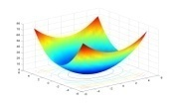
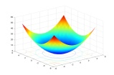
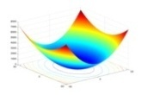
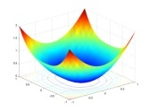
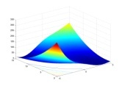
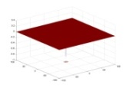
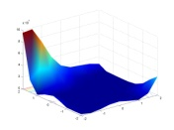
Standard Unimodal test functions considered
Test Function (F) | Function | 2D-Image | Range | F(x)
De-jong |  |  | [-5.12, 5.12] | 0
Axis parallel hyper-ellipsoid |  |  | [-5.12, 5.12] | 0
Rotated hyper-ellipsoid |  |  | [-65.536, 65.536] | 0
Sum of different power |  |  | [-1, 1] | 0
Branins |  |  | [-5, 10]x [0, 15] | 5/4 i.e. (0.39788)
Easom |  |  | [-100 ,100] | -1
Goldstein-Price |  |  | [-2, 2] | 3

Slide 48



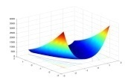

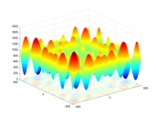



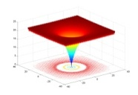






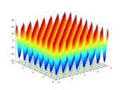

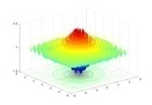
Standard Multimodal 16 test functions considered
Test Function (F) | Function | 2D-Image | Range | F(x)
Rastrigin |  |  | [ -5.12, 5.12] | 0
Rosenbrock |  |  | [-2.048, 2.048] | 0
Schwefel 2.26 |  |  | [-500, 500] | -418.9
Griewangk |  |  | [-600, 600] | 0
Ackley |  |  | [-32.768, 32.768] | 0
Michalewicz 5 |  |  | [ -3.1428 , 3.1428 ] | -4.687 D=5
Six-hump camel back |  |  | [-5, 5] | -1.0316
Shubert |  |  | [-10, 10] | -186.73 D=5
Drop wave |  |  | [-5.12, 5.12] | -2.1933

Slide 49
Parameter setting for SGA, SDPGA and MPDPGA
Operator/parameter | MPDPGA | SDPGA | SGA | DPGA^{l}
Initialization | Random | Random | Random | Random
Main Population size ( MP ) | 50 | 50 | 100 | 50
Reserve Population size ( RP ) | 50 | 50 | -- | 10
Selection | Tournament (sorted) | Tournament | Tournament | Tournament
Crossover type | K-point | K-point | K-point | Two-point
Crossover point K | 5 | 5 | 5 | 2
Mutation type | Flip bit | Flip bit | Flip bit | Bitwise
Crossover rate | 0.7 | 0.7 | 0.7 | 1.0
Mutation rate | 0.01 | 0.01 | 0.01 | 1 / l
Distance measure | Hamming | Hamming | --- | Hamming
Diversity Control | Fixed Crossbreeding | Fixed Crossbreeding | --- | Adaptive Crossbreeding
Stopping criteria | Generation/Optimal solution | Generation/Optimal solution | Generation/Optimal solution | Generation
DPGA and DPGA-ED are work of Park & Ryu, 2007 [150]

Slide 50
Comparison based on M, SD, SEM, BSF, FEBS and SR between SGA, SDPGA and MPDPGA for f1-f7
F | Algorithm | M | SD | SEM | MFE | BSF | FEBS | SR
f1 | MPDPGA | 0.00E+00 | 0.00E+00 | 0.00E+00 | 35650 | 0.00E+00 | 182 | 100
 | SDPGA | 2.67E-02 | 4.62E-02 | 1.46E-02 | 969250 | 0.00E+00 | 40405 | 70
 | SGA | 3.75E+00 | 2.08E-01 | 6.58E-02 | 6556450 | 5.82E-02 | 77105 | 0
f2 | MPDPGA | 0.00E+00 | 0.00E+00 | 0.00E+00 | 18900 | 0.00E+00 | 168 | 100
 | SDPGA | 0.00E+00 | 0.00E+00 | 0.00E+00 | 1341950 | 0.00E+00 | 40116 | 100
 | SGA | 4.65E-01 | 5.77E-01 | 1.82E-01 | 11130850 | 1.11E-02 | 190503 | 0
f3 | MPDPGA | 0.00E+00 | 0.00E+00 | 0.00E+00 | 285450 | 0.00E+00 | 2138 | 100
 | SDPGA | 0.00E+00 | 0.00E+00 | 0.00E+00 | 2681950 | 0.00E+00 | 80594 | 100
 | SGA | 0.00E+00 | 0.00E+00 | 0.00E+00 | 7856700 | 0.00E+00 | 95546 | 100
f4 | MPDPGA | 0.00E+00 | 0.00E+00 | 0.00E+00 | 44850 | 0.00E+00 | 300 | 100
 | SDPGA | 3.40E-03 | 5.77E-03 | 1.82E-03 | 846150 | 2.00E-06 | 30821 | 60
 | SGA | 1.01E-02 | 1.31E-02 | 4.14E-03 | 6512700 | 0.00E+00 | 1444 | 60
f5 | MPDPGA | 3.98E-01 | 4.32E-04 | 1.37E-04 | 557050 | 3.98E-01 | 122 | 100
 | SDPGA | 7.13E-05 | 1.11E-04 | 3.51E-05 | 3649450 | 4.00E-06 | 96821 | 60
 | SGA | 4.00E-01 | 2.12E-03 | 6.70E-04 | 7208700 | 3.99E-01 | 106411 | 0
f6 | MPDPGA | -1.00E+00 | 2.58E-07 | 8.16E-08 | 454700 | -1.00E+00 | 6523 | 100
 | SDPGA | -4.00E-04 | 5.29E-04 | 1.67E-04 | 678450 | -1.00E-03 | 1944 | 100
 | SGA | -1.00E+00 | 2.48E-07 | 7.84E-08 | 178200 | -1.00E+00 | 195600 | 90
f7 | MPDPGA | 3.01E+00 | 1.16E-02 | 3.67E-03 | 2605400 | 3.00E+00 | 2668300 | 100
 | SDPGA | -- | -- | -- | -- | -- | -- | --
 | SGA | 3.02E+00 | 3.96E-03 | 1.25E-03 | 6770600 | 3.01E+00 | 12720500 | 100

Slide 51
Comparison BSF, M, SD, FEBS and SR between SGA, SDPGA and MPDPGA for Multimodal functions (f8-f16)
F | Algorithm | M | SD | SEM | MFE | BSF | FEBS | SR
f8 | MPDPGA | 0.00E+00 | 1.02E-02 | 3.23E-03 | 257500 | 0.00E+00 | 26600 | 100
 | SDPGA | 1.98E-02 | 2.28E-02 | 7.21E-03 | 939350 | 0.00E+00 | 394900 | 90
 | SGA | 2.38E-02 | 1.66E-02 | 5.25E-03 | 2343450 | 0.00E+00 | 685000 | 20
f9 | MPDPGA | 0.00E+00 | 0.00E+00 | 0.00E+00 | 327300 | 0.00E+00 | 176700 | 100
 | SDPGA | 3.69E-02 | 3.33E-02 | 1.05E-02 | 13016100 | 0.00E+00 | 20739500 | 40
 | SGA | 2.38E-01 | 3.64E-02 | 1.15E-02 | 13284600 | 2.99E-02 | 14542000 | 30
f10 | MPDPGA | -4.19E+02 | 3.23E-03 | 1.02E-03 | 287950 | -4.18E+02 | 147900 | 100
 | SDPGA | 7.00E-03 | 1.13E-02 | 3.57E-03 | 330100 | 1.00E-05 | 860800 | 0
 | SGA | -- | -- | -- | -- | -- | -- | --
f11 | MPDPGA | 0.00E+00 | 2.69E-02 | 8.51E-03 | 197450 | 0.00E+00 | 5000 | 100
 | SDPGA | 2.39E-01 | 6.15E-02 | 1.94E-02 | 259050 | 1.72E-01 | 435700 | 0
 | SGA | 2.60E-01 | 2.42E-01 | 7.65E-02 | 2523750 | 2.35E-02 | 4794100 | 0
f12 | MPDPGA | 0.00E+00 | 0.00E+00 | 0.00E+00 | 221400 | 0.00E+00 | 64700 | 100
 | SDPGA | 6.22E-02 | 5.23E-02 | 1.65E-02 | 1568600 | 1.00E-05 | 384900 | 20
 | SGA | 9.70E-01 | 6.51E-01 | 2.06E-01 | 5164400 | 7.76E-01 | 1320400 | 10
f13 | MPDPGA | -3.79E+00 | 1.42E+00 | 4.49E-01 | 102000 | 4.69E+00 | 157400 | 70
 | SDPGA | -1.10E-06 | 1.15E-07 | 3.64E-08 | 119850 | -1.00E-07 | 317000 | 0
 | SGA | -- | -- | -- | -- | -- | -- | --
f14 | MPDPGA | -1.03E+00 | 4.93E-04 | 1.56E-04 | 41500 | -1.03E+00 | 10100 | 100
 | SDPGA | -- | -- | -- | -- | -- | -- | --
 | SGA | -1.03E+00 | 1.92E-04 | 6.07E-05 | 487800 | -1.03E+00 | 470100 | 90
f15 | MPDPGA | -1.86E+02 | 8.02E-02 | 2.54E-02 | 254450 | -1.86E+02 | 43600 | 100
 | SDPGA | -7.00E-04 | 1.13E-03 | 3.57E-04 | 1979000 | -2.00E-03 | 105900 | 0
 | SGA | -1.86E+02 | 7.02E+01 | 2.22E+01 | 696500 | -1.87E+02 | 1154100 | 70
f16 | MPDPGA | -1.00E+00 | 0.00E+00 | 0.00E+00 | 1030200 | -1.00E+00 | 17500 | 100
 | SDPGA | -3.41E-06 | 5.71E-06 | 1.81E-06 | 571200 | -1.00E-05 | 311000 | 0
 | SGA | 4.36E-01 | 6.23E-02 | 1.97E-02 | 6879500 | 3.98E-01 | 8865000 | 0

Slide 52
Discussion of MPDPGA on UNIMODAL and Multimodal Functions
It shows that the MPDPGA outperforms SDPGA and SGA in terms of BSF, M and Ideal F(x) value.
It shows that the MPDPGA is better than SDPGA and SGA in terms M, SD and SEM.
The SR shown by MPDPGA 100 percent .
It shows that the MPDPGA outperforms SDPGA and SGA.
Discussion of MPDPGA on Unimodal and multimodal functions
The MPDPGA outperform over SGA and SDPGA in terms of -
Reliability (success rate), Efficacy (mean and standard deviation), Efficiency (function evaluation) on the multicore system.

Slide 53
Performance evaluation with t-test of MPDPGA, SDPGA and SGA
comparison excel sheet

Slide 54
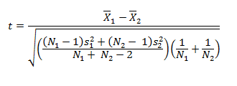
t-test of MPDPGA, SDPGA and SGA on Unimodal and multimodal functions
Where,
X1 – mean of the first sample,
S1 – standard deviation of the first sample,
X2 – mean of the second sample,
S2 – standard deviation of the second sample,
N1 – first sample size,
N2 – second sample size.
If the value of ‘t’ is positive, it means the second algorithm is better than first one and if it comes negative it means the first algorithm is better than second.

Slide 55
Metaheuristics that discovered significantly better solutions
The calculated values of the t statistic amongst MPDPGA, SDPGA and SGA
F | MPDPGA versus SDPGA | MPDPGA versus SGA | SDPGA versus SGA
f1 | MPDPGA | MPDPGA | SDPGA
f2 | MPDPGA | MPDPGA | SDPGA
f3 | MPDPGA | MPDPGA | SDPGA
f4 | MPDPGA | MPDPGA | SDPGA
f5 | -- | -- | SDPGA
f6 | MPDPGA | -- | --
f7 | -- | MPDPGA | --
f8 | MPDPGA | MPDPGA | SDPGA
f9 | MPDPGA | MPDPGA | SDPGA
f10 | MPDPGA | -- | --
f11 | MPDPGA | MPDPGA | SDPGA
f12 | MPDPGA | MPDPGA | SDPGA
f13 | MPDPGA | MPDPGA | SDPGA
f14 | -- | -- | --
f15 | MPDPGA | MPDPGA | --
f16 | MPDPGA | MPDPGA | SDPGA
F | MPDPGA versus SDPGA | MPDPGA versus SGA | SDPGA versus SGA
f1 | 1.96 | 57.01 | 55.30
f2 | 1.90 | 2.55 | 2.54
f3 | 1.25 | 3.49 | 2.38
f4 | 1.88 | 1.86 | 1.17
f5 | -7089.29 | -876.96 | 595.73
f6 | 4572.70 | 0.00 | -5975.30
f7 | NA | 2.58 | NA
f8 | 2.18 | 3.41 | 0.46
f9 | 3.57 | 2.07 | 1.74
f10 | 112742.70 | NA | NA
f11 | 10.59 | 3.19 | 0.27
f12 | 3.68 | 4.71 | 4.40
f13 | 8.44 | 9.41 | 11989187.00
f14 | NA | 0.00 | NA
f15 | 7372.63 | 0.05 | -8.38
f16 | 553812.06 | 72.89 | 22.13
t-test shows that MPDPGA is better than SDPGA and SGA

Slide 56
Comparison of MPDPGA with other Metaheurestic
(GA, Pso, NM-PSO, ABC, ANTS, GEM, DE and TLBO ) [184 and 187]

Slide 57
Statistical results of 30 runs obtained by GA, PSO, DE ABC, BCO and MDPGA algorithms for functions considered by Karaboga and Akay [184] and Nikoloc and Teodorovic [187].
F | MPDPGA (M) | MPDPGA (SD) | MPDPGA (SEM) | GA(M) | GA (SD) | GA (SEM) | PSO(M) | PSO(SD) | PSO (SEM) | DE(M) | DE(SD) | DE (SEM) | ABC(M) | ABC(SD) | ABC(SEM) | BCO(M) | BCO(SD) | BCO(SEM)
f₅ | 3.98E-01 | 4.32E-04 | 1.37E-04 | 3.98E-01 | 0.00E+00 | 0.00E+00 | 3.98E-01 | 0.00E+00 | 0.00E+00 | 3.98E-01 | 0.00E+00 | 0.00E+00 | 3.98E-01 | 0.00E+00 | 0.00E+00 | 3.98E-01 | 6.35E-08 | 1.16E-08
f₆ | -1.00E+00 | 2.58E-07 | 8.16E-08 | -1.00E+00 | 0.00E+00 | 0.00E+00 | -1.00E+00 | 0.00E+00 | 0.00E+00 | -1.00E+00 | 0.00E+00 | 0.00E+00 | -1.00E+00 | 0.00E+00 | 0.00E+00 | -1.00E+00 | 1.72E-11 | 3.15E-12
f₇ | 3.01E+00 | 1.16E-02 | 3.67E-03 | 5.25E+00 | 5.87E+00 | 1.07E+00 | 3.00E+00 | 0.00E+00 | 0.00E+00 | 3.00E+00 | 0.00E+00 | 0.00E+00 | 3.00E+00 | 0.00E+00 | 0.00E+00 | 3.00E+00 | 3.50E-10 | 6.39E-11
f₈ | 0.00E+00 | 1.02E-02 | 3.23E-03 | 5.29E+01 | 4.56E+00 | 8.33E-01 | 4.40E+01 | 1.17E+01 | 2.14E+00 | 1.17E+01 | 2.54E+00 | 4.63E-01 | 0.00E+00 | 2.54E+00 | 4.63E-01 | 3.84E-09 | 1.15E-09 | 2.09E-10
f₉ | 0.00E+00 | 0.00E+00 | 0.00E+00 | 1.96E+05 | 3.85E+04 | 7.03E+03 | 1.51E+01 | 2.42E+01 | 4.41E+00 | 1.82E+01 | 5.04E+00 | 3.33E-02 | 8.88E-02 | 7.74E-02 | 1.41E-02 | 1.06E+01 | 1.66E+01 | 3.03E+00
f₁₁ | 0.00E+00 | 2.69E-02 | 8.51E-03 | 1.06E+01 | 1.16E+00 | 2.12E-01 | 1.74E-02 | 2.08E-02 | 3.80E-03 | 1.48E-03 | 2.96E-03 | 5.40E-04 | 0.00E+00 | 0.00E+00 | 0.00E+00 | 3.25E-03 | 7.35E-06 | 1.55E-06
f₁₂ | 0.00E+00 | 0.00E+00 | 0.00E+00 | 1.47E+01 | 1.78E-01 | 3.25E-02 | 1.65E-01 | 4.94E-01 | 2.07E-02 | 0.00E+00 | 0.00E+00 | 0.00E+00 | 0.00E+00 | 0.00E+00 | 0.00E+00 | 7.35E-06 | 1.55E-06 | 2.83E-07
f₁₃ | -3.79E+00 | 1.42E+00 | 4.49E-01 | -4.64E+00 | 9.79E-02 | 1.79E-02 | -2.49E+00 | 2.57E-01 | 4.69E-02 | -4.68E+00 | 1.53E-02 | 2.29E-03 | -4.69E+00 | 0.00E+00 | 0.00E+00 | -4.69E+00 | 8.04E-10 | 1.47E-10
f₁₄ | -1.03E+00 | 4.93E-04 | 1.56E-04 | -1.03E+00 | 0.00E+00 | 0.00E+00 | -1.03E+00 | 0.00E+00 | 0.00E+00 | -1.03E+00 | 0.00E+00 | 0.00E+00 | -1.03E+00 | 0.00E+00 | 0.00E+00 | -1.03E+00 | 1.18E-11 | 2.15E-12
f₁₅ | -1.86E+02 | 8.02E-02 | 2.54E-02 | -1.87E+02 | 0.00E+00 | 0.00E+00 | -1.87E+02 | 0.00E+00 | 0.00E+00 | -1.87E+02 | 0.00E+00 | 0.00E+00 | -1.87E+02 | 0.00E+00 | 0.00E+00 | -1.87E+02 | 2.01E-10 | 3.67E-11

Slide 58
Performance evaluation with t-test of MPDPGA and other metaheurestics
(GA, PSO, DE and ABC ) [187]

Slide 59
The calculated values of the t statistic amongst MPDPGA and other metaheurestics
Metaheuristics that discovered significantly better solutions
F | MPDPGA vs. GA | MPDPGA vs. PSO | MPDPGA vs. DE | MPDPGA vs. ABC | MPDPGA vs. BCO
f5 | -1.30 | -1.30 | -0.73 | -0.75 | -1.3
f6 | -48.00 | -4857.92 | -2729.92 | -2804.72 | -4857.9
f7 | 1.20 | -4.85 | -2.73 | -2.80 | -4.72
f8 | 36.37 | 11.79 | 14.57 | 0.00 | 0.00
f9 | 15.96 | 1.96 | 11.42 | 2.08 | 3.50
f11 | 28.34 | 2.13 | 0.17 | 0.00 | 0.66
f12 | 258.89 | 1.05 | 0.00 | 0.00 | 25.97
f13 | -3.35 | 4.89 | -1.99 | -2.07 | -3.5
f14 | 15.59 | 15.59 | 8.76 | 9.00 | 15.18
f15 | -69.66 | -69.66 | -39.15 | -40.22 | -67.8
F | MPDPGA vs. GA | MPDPGA vs. PSO | MPDPGA vs. DE | MPDPGA vs. ABC | MPDPGA vs. BCO
f5 | GA | PSO | DE | ABC | BCO
f6 | GA | PSO | DE | ABC | BCO
f7 | MPDPGA | PSO | DE | ABC | BCO
f8 | MPDPGA | MPDPGA | MPDPGA | Both equal | Both equal
f9 | MPDPGA | MPDPGA | MPDPGA | MPDPGA | MPDPGA
f11 | MPDPGA | MPDPGA | MPDPGA | Both equal | MPDPGA
f12 | MPDPGA | MPDPGA | Both equal | Both equal | MPDPGA
f13 | GA | MPDPGA | DE | ABC | BCO
f14 | MPDPGA | MPDPGA | MPDPGA | MPDPGA | MPDPGA
f15 | GA | PSO | DE | ABC | BCO

Slide 60
Discussion of MPDPGA for functions considered
By Akay and Karaboga [187]
The MPDPGA’s is outperforming over GA, PSO, DE and ABC in terms of mean.
Over all, the MPDPGA outperforms over GA, PSO, DE and ABC in terms of mean and standard deviation (efficacy).
by t-test, MPDPGA outperform over all other metaheuristics.

Slide 61
Comparison based on MFE and SR of MPDPGA with PSO, NM-PSO, and TLBO [183]

Slide 62
Comparison based on MFE and SR shown by MPDPGA with PSO, NM-PSO, and TLBO for functions considered by Shu and Erwie [183].
F | MPDPGA (MFE) D=2 | MPDPGA (SR) | PSO (MFE) | PSO (SR) | NM-PSO (MFE) | NM-PSO (SR) | TLBO (MFE) | TLBO (SR)
f8 | 5150 | 100% | 510050 | 0% | 12353 | 60% | 1134 | 100%
f11 D=10 | 3949 | 100% | 504657 | 30% | 14076 | 82% | 1059 | 100%

Slide 63
Comparison based on MFE and Success Rate of MPDPGA with GA, ANTS, Bee Colony, GEM and TLBO [185]

Slide 64
Comparison based on MFE and Success Rate shown by MPDPGA with GA, ANTS, Bee Colony, GEM and TLBO for functions considered by Ahrari and Atai [185]
F | MPDPGA (MFE) D=2 | MPDPGA (SR) | GA (MFE) | GA (SR) | ANTS (MFE) | ANTS (SR) | Bee Colony (MFE) | Bee Colony (SR) | GEM (MFE) D=1 | GEM (SR) | TLBO (MFE) | TLBO (SR)
f1 | 713 | 100% | 10160 | 100% | 6000 | 100% | 868 | 100% | 746 | 100% | 676 | 100%
f9 D=1 | 6546 | 100% | 10212 | 100% | 6842 | 100% | 631 | 100% | 572 | 100% | 541 | 100%

Slide 65
Comparison based on MFE shown by MPDPGA with GA, ANTS, Bee Colony, GEM and TLBO for functions considered by Ahrari and Atai [185]

Slide 66
Discussion of MPDPGA for functions considered
by Ahrari and Atai ^{[185]}
The MPDPGA’s is outperforming over GA and ANTS but not over the Bee Colony, GEM and TLBO in terms of AES.
The MPDPGA’s SR performance is almost equal with GA, ANTS, Bee Colony, GEM and TLBO.

Slide 67
Comparison based on Mean shown by MPDPGA with PSO, DE, ABC and TLBO [186]

Slide 68
Comparison based on Mean shown by MPDPGA with PSO, DE, ABC and TLBO for functions considered by Rao, Savsani and Vakharia [186].
F | MPDPGA (M) | PSO(M) | DE (M) | ABC(M) | TLBO(M)
f8 | 0.00E+00 | 1.03E+03 | 5.95E+02 | 8.80E+01 | 0.00E+00
f9 | 0.00E+00 | 1.09E+06 | 8.72E+10 | 1.01E+03 | 4.98E+02
f11 | 0.00E+00 | 2.20E+00 | 6.45E-01 | 0.00E+00 | 0.00E+00
f12 | 0.00E+00 | 3.69E+00 | 1.30E+01 | 5.80E-02 | 0.00E+00

Slide 69
Discussion on for functions considered
Rao, Savsani and Vakharia [186]
The MPDPGA is outperforming over PSO, DE, ABC and TLBO in terms of mean.

Slide 70
Discussion on comparison with all above Metaheuristic given in [183], [184], [185], [186] and [187]
The MPDPGA is performing better than GA, PSO, DE and ANTS not over ABC and TLBO in terms of reliability (success rate), efficacy (mean and standard deviation) and efficiency (function evaluation).

Slide 71
Comparison of MPDPGA with diversity based Metaheurestic
(DPGA, StGA, IMGA, RTS ) [155], (DGEP, CEP and ALEP) [187]

Slide 72
Comparison based on SD and M shown by MPDPGA with DPGA*, StGA, IMGA and RTS for functions considered by Park and Ryu [155].
F | MPDPGA(M) | MPDPGA (SD) | DPGA^{l*} (M) | DPGA* (SD) | StGA (M) | StGA (SD) | IMGA M) | IMGA (SD) | RTS (M) | RTS (SD)
f₈ | 0.00E+00 | 1.02E-02 | 6.15E-02 | 2.46E-01 | 4.48E-01 | 9.04E-01 | 2.34E-01 | 8.31E-01 | 1.79E+00 | 1.82E+00
f₉ | 0.00E+00 | 0.00E+00 | 3.23E+01 | 3.34E+01 | 4.71E+01 | 3.79E+01 | 4.19E+01 | 3.78E+01 | 4.10E+01 | 3.66E+01
f₁₀ | -4.19E+02 | 3.23E-03 | -1.26E+01 | 0.00E+00 | -1.26E+04 | 0.00E+00 | -1.26E+04 | 2.80E+01 | -1.26E+04 | 1.70E+01
f₁₁ | 0.00E+00 | 2.69E-02 | 5.13E-02 | 4.75E-02 | 1.11E-01 | 5.79E-02 | 6.88E-02 | 4.97E-02 | 3.67E-02 | 4.45E-02
f₁₂ | 0.00E+00 | 0.00E+00 | 0.00E+00 | 0.00E+00 | 2.36E-02 | 2.86E-02 | 1.00E-03 | 7.40E-03 | 0.00E+00 | 0.00E+00
* DPGA and DPGA-ED are work of Park & Ryu, 2007 [150]

Slide 73
t-test of MPDPGA and diversity based metaheurestics
(DPGA*, StGA, IMGA and RTS)

Slide 74
The calculated values of the t statistic amongst MPDPGA and other metaheurestics
Metaheuristics that discovered significantly better solutions
F | MPDPGA vs DPGA^{l} | MPDPGA vs StGA | MPDPGA vs IMGA | MPDPGA vs RTS
f3 | 0.78 | 1.55 | 0.88 | 3.09
f4 | 3.03 | 3.90 | 3.48 | 3.51
f5 | 708021.50 | -21167825.50 | -1359.54 | -2240.17
f6 | 3.23 | 5.80 | 4.15 | 2.45
f7 | 0.00 | 2.59 | 0.42 | 0
F | MPDPGA vs DPGAl | MPDPGA vs StGA | MPDPGA vs IMGA | MPDPGA vs RTS
f3 | MPDPGA | MPDPGA | MPDPGA | MPDPGA
f4 | MPDPGA | MPDPGA | MPDPGA | MPDPGA
f5 | MPDPGA | StGA | IMGA | RTS
f6 | MPDPGA | MPDPGA | MPDPGA | MPDPGA
f7 | MPDPGA | MPDPGA | MPDPGA | MPDPGA
DPGA and DPGA-ED are work of Park & Ryu, 2007 [150]

Slide 75
Discussion of MPDPGA’s comparison with DPGA^{l}, StGA, IMGA and RTS [155]
It shows that the MPDPGA outperforms DPGA*, StGA, IMGA and RTS in terms of mean.
It shows that the MPDPGA outperforms DPGA*, StGA, IMGA and RTS in terms of standard deviation.
By t-test, MPDPGA outperform over DPGA*, StGA, IMGA and RTS diversity based metaheurestic.

Slide 76
Comparison based on M and SD shown by MPDPGA with DGEP, CEP and ALEP [188].
F | MPDPGA (M) | MPDPGA (SD) | DGEP(M) | DGEP(SD) | CEP(M) | CEP(SD) | ALEP(M) | ALEP(SD)
f5 | 3.98E-01 | 4.32E-04 | 3.98E-01 | 2.40E-07 | 9.38E-01 | 1.50E-07 | -- | --
f7 | 3.01E+00 | 1.16E-02 | 3.00E+00 | 0.00E+00 | 3.00E+00 | 0.00E+00 | 3.00E+00 | 0.00E+00
f8 | 0.00E+00 | 1.02E-02 | 0.00E+00 | 5.12E-09 | 8.90E+01 | 2.13E+01 | 5.85E+00 | 2.07E+00
f9 | 0.00E+00 | 0.00E+00 | 1.28E+00 | 7.60E-01 | 6.17E+00 | 1.36E+01 | 4.34E+01 | 3.15E+01
f11 | 0.00E+00 | 2.69E-02 | 0.00E+00 | 2.54E-14 | 8.60E-02 | 1.20E-01 | 2.40E-02 | 2.80E-06
f12 | 0.00E+00 | 0.00E+00 | 0.00E+00 | 6.83E-17 | 9.20E+00 | 2.80E+00 | 1.90E-02 | 1.00E-03
f14 | -1.03E+00 | 4.93E-04 | -1.03E+00 | 0.00E+00 | -1.03E+00 | 4.90E-07 | -1.03E+00 | 0.00E+00

Slide 77
Comparison based on M shown by MPDPGA with DGEP, CEP and ALEP [188]

Slide 78
Comparison based on SD shown by MPDPGA with DGEP, CEP and ALEP [188]

Slide 79
t-test of MPDPGA and diversity based metaheurestics
(DGEP, CEP and ALEP) [188]

Slide 80
The calculated values of the t statistic amongst MPDPGA and other metaheurestics
Metaheuristics that discovered significantly better solutions
F | MPDPGA vs DGEP | MPDPGA vs CEP | MPDPGA vs ALEP
f5 | -1.30 | 7032.84 | NA
f7 | -4.85 | -4.85 | -2.73
f8 | 0.00 | 13.10 | 8.94
f9 | 5.28 | 1.42 | 4.35
f11 | 0.00 | 2.23 | 2.82
f12 | 0.00 | 10.30 | 0.00
f14 | 4.18 | 4.18 | 2.35
F | MPDPGA vs DGEP | MPDPGA vs CEP | MPDPGA vs ALEP
f5 | DGEP | MPDPGA | ALEP
f7 | DGEP | CEP | ALEP
f8 | Both equal | MPDPGA | MPDPGA
f9 | MPDPGA | MPDPGA | MPDPGA
f11 | Both equal | MPDPGA | MPDPGA
f12 | Both equal | MPDPGA | Both equal
f14 | MPDPGA | MPDPGA | MPDPGA

Slide 81
Discussion on comparison of MPDPGA with population diversity based metaheuristic [155] and [188]
The student t test results show that, MPDPGA is discovered significantly better solutions over metaheuristics DPGA*, StGA, IMGA , RTS, DGEP, CEP and ALEP.

Slide 82
Publications : Journals
Paper titled “Multithreaded Parallel Dual Population Genetic Algorithm (MPDPGA) for unconstrained function optimizations on multicore system”, Applied Mathematics and Computation, Vol 243, pp. 236-249, 2014. 15 September 2014. (TR Impact Factor 1.686/ Source Normalized Impact per Paper (SNIP): 1.378/ SCImago Journal Rank (SJR): 0.958) DOI: 10.1016/j.amc.2014.06.033 http://www.sciencedirect.com/science/article/pii/S0096300314008698 Paper link
Paper titled “Dual Population Genetic Algorithm (GA) versus OpenMP GA for Multimodal Function Optimization”, published in peer reviewed, indexed, Immediacy Index 0.259 and impact factor 0.814 journal: International Journal of Computer Applications (ISSN 0975 – 8887), Volume 64 - Number 19, pp. 29-36, February 2013. http://www.ijcaonline.org/archives/volume64/number19/10744-5516 Paper link
Paper titled “Review of parallel genetic algorithm based on computing paradigm and diversity in search space”, ICTACT Journal on Soft Computing, volume -3, issue 4, pp. 615-622, September 2013. (Index Copernicus Value (ICV): 5.09) ISSN Number (Print) 0976-6561, ISSN Number (Online) 2229-6956, Published By ICT Academy of Tamilnadu. http://ictactjournals.in/paper/IJSCPaper_7_615to622.pdf Paper link
Research paper titled “Comparative study of Diversity based Parallel Dual Population Genetic Algorithm for unconstrained function optimizations”, accepted to International Journal of Bio-Inspired Computation, Inderscience, on 05 January, 2015. TR impact factor 2014: 3.969, (5-Year Impact Factor: 2.778, Total Cites: 467) [Accepted and will come in vol. 8 no. 4] Paper link

Slide 83
Publications : International Conference
A. J. Umbarkar and Mrs. M. S. Joshi, “Serial DPGA vs. Parallel Multithreaded DPGA: Threading Aspects” in International conference on "Soft Computing for Problem Solving (SOCPROS 2011)" at IIT Roorkee, December 20-22, 2011. It is published in "Advances in Intelligence and Soft computing (AISC 130), series of Springer publication, pp. 37–49, 2012. Print ISBN 978-81-322-0486-2, Online ISBN 978-81-322-0487-9, Series ISSN 1867-5662, Publisher -Springer India. DOI: 10.1007/978-81-322-0487-9_5 http://link.springer.com/chapter/10.1007%2F978-81-322-0487-9_5 Paper link
At glace publications: Journal: 04 International Conference: 01

Slide 84
Conclusion
MPDPGA significantly better over SDPGA and SGA in terms of reliability (success rate), efficacy (mean, standard deviation and standard error of mean) and efficiency (function evaluation).
The CPU utilization is optimized and almost stable (~50%) in MPDPGA for said configuration. (Elsevier AMC)
MPDPGA perform better over MPDPGA-ED in terms generation and best solution found. (Elsevier AMC)
MPDPGA performance is compared with metaheuristics such as -GA, PSO, ANTS, Bee colony, DE, BCO, TLBO and GEM. MPDPGA is better over metaheuristics like GA, PSO, ANTS, Bee colony, DE, BCO and, GEM. (Inderscience IJBIC)
MPDPGA performance is compared with diversity based metaheuristics. MPDPGA is better over diversity based metaheuristics DPGA, IMGA, RTS, StGA, CEP and ALEP.
DPGA is algorithmically parallel and performs better than OpenMp GA and SGA. (IJCA)
The algorithmic design is more important than only parallel implementation. (IJCA)
DPGA shows speedup over OpenMp GA and SGA. (IJCA)

Slide 85
RESEARCH CONTRIBUTIONS
Parallel design of DPGA (called MPDPGA or PDPGA) is proposed. It works efficiently on a multicore system. (contribution) (Elsevier AMC/Inderscience IJBIC/IJCA)
In MPDPGA, the computationally effective modified fitness function is proposed for reserve population. (contribution) (Elsevier AMC)
The population diversity and premature convergence problems are solved and convergence rate improved. (contribution) (Elsevier AMC)

Slide 86
Future Scope
Proposed algorithm shows better exploration and exploitation capacity, it can be further improved by adding more reserve populations on latest computing infrastructure like multicore, manycore and GPGPU computing systems.
Proposed work can extend as multithreaded Parallel Multiple Reserve Population GA (PMRPGA), where following issues can be addressed:
Multiple critical sections can arise and could be solved in future scope.
The number of reserve populations could be increased to increase exploration of search space and improve PC (Premature Convergence) and CR (Convergence Rate).
Computational effective fitness function can be used for reserve populations.
Experimentation of PMRPGA can be tested or experimented on multicore and many core systems with the latest test problem set.

Slide 87
references
Arvind, D. August, K. P. D. Chiou, R. Sendag and J. J. Yi, Programming Multicores: Do Application Programmers Need to Write Explicitly Parallel Programs? Computer Architecture Debates in IEEE MICRO, pp. 19-32, May/June 2010.
J.H. Holland, “Adaptation in Natural and Artificial System”, Ann Arbor: The University of Michigan Press, (2nd ed. MIT Press), 1975.
L.J. Eshelman and J.D. Schaffer, Preventing premature convergence in genetic algorithms by preventing incest, in: R. Belew, L.B. Booker (Eds.), Proceedings of the Fourth International Conference on Genetic Algorithms, Morgan Kaufmann, San Mateo, CA, pp. 115–122, 1991.
D.E. Goldberg, Genetic Algorithms in Search Optimization, and Machine Learning, Addison-Wesley, Reading, MA, 1989.
S. Shah, R. Kothari, J. Jayadeva and S. Chandra, “Mathematical modeling and convergence analysis of trail formation”, in Proceedings of the 23rd national conference on Artificial intelligence - Volume 1 (AAAI'08), pp. 170-175, 2008.
S. J. Louis and G. J. E. Rawlins “Syntactic Analysis of Convergence in Genetic Algorithms”, Advances in Computational Optimization and it applications, University Press, pp. 46-50, 1992.
R.Sivaraj and T. Ravichandran” A Review of Selection methods in Genetic Algorithm” International Journal of Engineering Science and Technology (IJEST), Vol. 3, No. 5, May 2011.
D. T. Gwiazda, Genetic algorithms reference Volume I Crossover for single- objective numerical optimization problems, eBook Publisher: Tomasz Gwiazda, 2006.
D. T. Gwiazda, Genetic Algorithms Reference Volume 2 Mutation Operator for Numerical Optimization Problems, eBook Publisher: Tomasz Gwiazda. 2006.
H. Mühlenbein, “Parallel genetic algorithms, population genetics and combinatorial optimization”, In Proceedings of the Third International Conference on Genetic Algorithms [ICGA3], pp. 416-421, 1989.
H. Mühlenbein, M. Schomisch, and J. Born, “The parallel genetic algorithm as function optimizer”, Parallel Computing, 17, pp.619-632, 1991.
F. Hidrobo and J. Aguilar, “Toward a parallel genetic algorithm approach based on collective intelligence for combinatorial optimization problems”. In Proceedings of the 1998 IEEE International Conference on Evolutionary Computation, Anchorage, AK (USA), pp. 715–720, May 1998.
T. Starkweather, D. Whitley, and K. Mathias, “Optimization using Distributed Genetic Algorithms”, In Parallel Problem Solving from Nature [PPSN1], pp. 176-185, 1991.
G. G. Robertson, “Parallel Implementation of Genetic Algorithms in a Classifier System”, In Proceedings of the Second International Conference on Genetic Algorithms [ICGA2], pp. 140-147, 1987.

Slide 88
references
Continued….
F. Corno, P. Prinetto, M. Rebaudengo, and M.S.Reorda, “ Exploiting Competing Subpopulation(s) for Automatic Generation of Test Sequences for Digital Circuits”, In Parallel Problem Solving from Nature[PPSN4], pp. 792-800, 1996.
J. G. Qi, G. R. Burns and D. K. Harrison. “The application of parallel multipopulation genetic algorithms to dynamic job-shop scheduling”, International Journal of Advanced Manufacturing Technology, 16(8), pp. 609- 615, 2000.
M. Singh, A. Chatterjee and S. Chaudhury, “Matching structural shape descriptions using genetic algorithms”, Pattern Recognition, 30(9) pp.1451–1462, September 1997.
B. B. Prahlada Rao and R. C. Hansdah, “Extended distributed genetic algorithm for channel routing”, In Proceedings of the Fifth IEEE Symposium on Parallel and Distributed Processing, IEEE Computer Society Press, Los Alamitos, CA, pp. 726–733, December 1993.
L. Wang, A. A. Maciejewski, H. J. Siegel, V. P. Roychowdhury and B. D. Eldridge, “ A study of five parallel approaches to a genetic algorithm for the traveling salesman problem”, Intelligent Automation and Soft Computing, 11(4) pp. 217-234, 2005.
V. Sundararajan and A. S. Kolaskar, “Parallel genetic algorithms on PARAM for confirmation of biopolymers”, In Proceedings of the 1996 3rd International Conference on High Performance Computing (HiPC, IEEE Computer Society Press, Los Alamitos, CA),Trivandrum (India), pp.22-26, December 1996.
L. A. Anbarasu, P. Narayanasamy and V. Sundararajan, “Multiple molecular sequence alignment by island parallel genetic algorithm”, Current Science, 78(7), pp. 858–863, 10 April 2000.
E. Cant u Paz, “Designing Efficient and accurate parallel genetic algorithms”, IlliGAL Report No.-99017, Urbana IL: University of Illinois at Urbana Champaign, Illinois Genetic Algorithms laboratory,1999.
P. N. Suganthan, N. Hansen, J. J. Liang, K. Deb, Y. -P. Chen, A. Auger2 and S. Tiwari3, “Problem Definitions and Evaluation Criteria for the CEC 2005 Special Session on Real-Parameter Optimization” Technical Report of CEC 2005, Report Number 2005005, Nanyang Technological University, Singapore and KanGAL(Kanpur Genetic Algorithms Laboratory, IIT Kanpur) , May 2005.
J.D. Farmer, N. Packard, A. Perelson, “The immune system, adaptation and machine learning”, Physica 22 pp.187–204, 1986
M. Dorigo, “Optimization, learning and natural algorithms”, PhD Dissertation, Politecnico di Milano, Italy, 1992.
J. Kennedy, R. C. Eberhart, “Particle swarm optimization”, Proceedings IEEE International Conference on Neural Networks, Piscataway, pp. 1942–1948, 1995.
S. S Hykin, Neural Network: A comprehensive Foundation, Prentice hall, pp. 1-889, 1999.
R. Storn, K. Price, “Differential evolution–a simple and efficient heuristic for global optimization over continuous spaces”, J. Glob. Optim. 11, pp. 341–359, 1997.
Z. W. Geem, J. H. Kim, G. V. Loganathan, “A new heuristic optimization algorithm: Harmony Search Simul”, the Soc. for Model and Simul. Int. 76(2), pp. 60–68, 2001.

Slide 89
references
Continued….
K. M. Passino, “Biomimicry of bacterial foraging for distributed optimization and control”, IEEE Control Syst. Mag. 22, pp.52–67, 2002.
M. Eusuff, E. Lansey E, “Optimization of water distribution network design using the shuffled frog leaping algorithm”, J. Water Resour. Plan Manag. ASCE 129, pp. 210–225, 2003.
D. Karaboga, “An idea based on honey bee swarm for numerical optimization”, Technical Report-TR06, Erciyes University, Engineering Faculty, Computer Engineering Department, Turkey, 2005.
D. Simon, “Biogeography-based optimization”, IEEE Trans Evol. Comput. 12, pp. 702–713, 2008.
E. Rashedi, H. Nezamabadi-pour, S. Saryazdi, “GSA: a gravitational search algorithm” Inf Sci 179, pp. 2232–2248, 2009.
A. Ahrari, A. Atai “Grenade Explosion Method-A novel tool for optimization of multimodal functions”, Appl Soft Comput 10(4), pp. 1132–1140, 2010.
R. V. Rao and V. J. Savsani, “Mechanical Design Optimization Using Advanced Optimization Techniques”, Springer Series in Advanced Manufacturing, Springer-Verlag London 2012.
J. T. Alander, “An Indexed Bibliography of Genetic Algorithms in Operations Research”, Report Series No. 94-1-PATENT, University of Vaasa, Finland, August 2008.
J. T. Alander, “An Indexed Bibliography of Distributed Genetic Algorithms”, Report Series No. 94-1-INDIA, University of Vaasa, Finland, July 2009.
X. Shengjun, G. Shaoyong and B. Dongling, “The Analysis and Research of Parallel Genetic Algorithm”, in IEEE 4th International Conference on Wireless Communications, Networking and Mobile Computing, WiCOM '08, pp 1-4. 2008.
M. Nowostawski and R. Poli, ”Parallel genetic algorithm taxonomy,” in Proc. 3rd International Conference on Knowledge-Based Intelligent Information Engineering Systems, Adelaide, Australia, pp. 88-92, 1999.M. A. Ismail, “Parallel Genetic Algorithms (PGAs): Master Slave Paradigm Approach Using MPI”, in E-Tech 2004, pp. 83-86, 2004.
E. Cantú-Paz and D. E. Goldberg, “On the scalability of parallel genetic algorithms”, Journal of Evolutionary Computation, Volume 7 Issue 4, pp, 429-449, 1999.
E. Cant u Paz, “Designing scalable Multipopulation parallel genetic algorithms”, IlliGAL Report No.-98009, Urbana IL: University of Illinois at Urbana Champaign, Illinois Genetic Algorithms laboratory, 1998.
A. Munawar, M. Wahib, M. Munetomo and K. Akama , “A Survey: Genetic Algorithms and the Fast Evolving World of Parallel Computing”, The 10th IEEE International Conference on High Performance Computing and Communications, pp. 897-902, 2008.
E. Alba and J. Troya, “A survey of parallel distributed genetic algorithms”, Complexity, Volume 4, Issue 4, Wiley, pp. 31–52, 1999.
K.C. Tan, Y.J. Yang and C.K. Goh, “A Distributed Cooperative Co evolutionary Algorithm for Multiobjective Optimization”, IEEE Transactions on Evolutionary Computation, Vol. 10, No. 5, pp. 527--549, October 2006.

Slide 90
references
Continued….
B. Manderick and P. Spiessens, “Fine-grained Parallel Genetic Algorithms”, In Proceedings of the Third International Conference on Genetic Algorithms [ICGA3], pp. 428-433, 1989.
H. Mühlenbein, “Evolution in Time and Space - The Parallel Genetic Algorithm”, In FGA1, pp. 316-337, 1991.
C. B. Pettey, M. R. Leuze and J. J. Grefenstette, “A Parallel Genetic Algorithm”, In Proceedings of the Second International Conference on Genetic Algorithms [ICGA2], pp. 155-161, 1987.
E. Cant´u-Paz, Efficient and Accurate Parallel Genetic Algorithms. Kluwer Academic Publishers, 2000.
M. Sefrioui and J. P´eriaux. A Hierarchical Genetic Algorithm Using Multiple Models for Optimization. Parallel Problem Solving from Nature VI., Paris, France, pp. 879-888, 2000.
X. Yu · M. Gen, Introduction to Evolutionary Algorithms, Springer-Verlag, pp.165-191, 2010.
X. Yu and M. Gen, Introduction to Evolutionary Algorithms, Springer-Verlag London Limited, pp. 105-111, 2010.
G. Luque, E. Alba, Parallel Genetic Algorithms, Springer, 2011.
G. M. Amdahl, “Validity of the single-processor approach to achieving large scale computing Capabilities”, In AFIPS Conference Proceedings, AFIPS Press, Vol. 30, pp. 483-485, 1967.
M. D. Hill and M. R. Marty, “Amdahl’s Law in the Multicore Era”, Iin IEEE Computer Society, pp. 33-38, 2008.
J. Gustafson, “Reevaluating Amdahl’s Law”, in Communications of the ACM, Vol. 31(5), pp. 532-533. 1988.
E. Ipek, M. Kırman, N. Kırman, and F. J. Martınez, “Core Fusion: Accommodating Software Diversity in Chip Multiprocessors,” Proc. 34th Ann. Int’l Symp. Computer Architecture, ACM Press, 2007, pp. 186-197.
T. G. Crainic and M. Toulouse, “Parallel Metaheuristics”, A report, Centre de recherche sur les transports, Universit´e de Montr´eal, Canada, pp 53-58, 1997..
V. Cung, L. S. Martins, C. C. Ribeiro and C. Roucairol, “Strategies for the Parallel Implementation of Metaheuristics”, A report, Laboratoire PRiSM-CNRS, Universit´e de Versailles, France, 2001.
J. Stender, “Parallel Genetic Algorithms: Theory and Applications”, IOS Press, 1993.
Y. Fan, T. Jiang and D. Evans, “Medical Image Registration Using Parallel Genetic Algorithms”, in Applications of Evolutionary Computing EvoWorkshops: EVOIASP Talks, Kinsale, Ireland, pp. 304-314, 2002.
G. Olague, “Autonomous Photogrammetric Network design Using Genetic Algorithms”, in Applications of Evolutionary Computing EvoWorkshops:EVOIASP, Como, Italy, pp. 353- 364, 2001.
H. He, O. S´ykora and A. Salagean, “Various island-based parallel Genetic algorithms for the 2- page drawing problem”, in 24th IASTED, Int. Conf. on Parallel and Distributed Computing and Networks, IASTED, Innsbruck, Austria, pp. 316-323, 2006.
M. Lazarova, “Efficiency of parallel genetic algorithm for solving N-queens problem on multicomputer platform”, in 9th WSEAS, Int. Conf. on Evolutionary Computing, Artificial Intelligence Series, Sofia, Bulgaria, pp. 51-56, 2008.
T. C. Belding, “The distributed genetic algorithm revisited”, in Eschelman, L. (Ed.), Proceedings of the Sixth International Conference on Genetic Algorithms, Morgan Kaufmann,San Francisco, CA, pp. 114-121, 1995.

Slide 91
references
Continued….
P. Cal´egari, F. Guidec and P. Kuonen, “A parallel genetic approach to transceiver placement optimization”, Tech. Report, Swiss Federal Institute of Technology, Lausanne, Switzerland, pp. 4, 1996.
D. Eby, C.R. Averill, B. Gelfand, F. W. Punch, O. Mathews and D. E. Goodman, “ An Injection Island GA for Flywheel Design Optimization”, in 5th European Congress on Intell. Techniques and SoftComputing, pp. 687-691, 1997.
S. C. Lin, W. Punch and E. Goodman, “Coarse-grain parallel genetic algorithms: Categorization and new approach”, in Sixth IEEE Symphosium on Parallel and Distributed Processing, IEEE Computer Society Press, Los Alamitos, CA, pp. 28-37, 1994.
D. Eby, C. R. Averill., F. W. Punch and D. E. Goodman, “ Evaluation of Injection Island GA Performance on Flywheel Design Optimization,” in Third Conference on Adaptive Computing in Design and Manufacturing, Plymouth, England, pp. 121-136, 1998.
H. M¨uhlenbein, M. Schomisch and J. Born, “The parallel genetic algorithm as function optimizer”, in Proc. of the Fourth Intl. Conf. on Genetic Algorithms, Morgan-Kaufmann, San Mateo, CA, pp. 271-278, 1991.
R. Shonkwiler, F. Mendivil and A. Deliu, “Genetic Algorithms for the 1-D Fractal Inverse Problem”, in Proceedings of the Fourth International Conference on Genetic Algorithms, Morgan Kaufmann, San Mateo, CA, pp. 495-501, 1991.
Z. Konfrst, “Parallel Genetic Algorithm: Advances, Computing Trends, application and Perspective”, in proceeding of 18th International Parallel and Distributed Processing Symposium [IPDPS’04], IEEE Computer Society, 2004.
E. Cantú-Paz, “A Survey of Parallel Genetic Algorithms”, Report- Department of Computer Science and Illinois Genetic Algorithms Laboratory University of Illinois at Urbana-Champaign, 2002.
C. Gagn´e, M. Parizeau and M. Dubreuil, “The Master-Slave Architecture for Evolutionary Computations Revisited”, in proceedings of Genetic and Evolutionary Computation Conference, Chicago, IL, 2, pp. 1578-1579, 2003.
S. Lin, W. Punch and E. Goodman E, “Coarse-grain parallel genetic algorithms: categorization and analysis”, In IEEE Symposium on Parallel and Distributed Processing, pp. 27–36, 1994.
M. Bubak and K. Sowa, “Object-oriented implementation of parallel genetic algorithms. High Performance Cluster Computing”, Programming and Applications, Vol. 2, Prentice Hall, 1999, pp. 331-349, 1999.
G. A. Sena, D. Mergherbi and G. Isern, “Implementation of a parallel genetic algorithm on a cluster of workstations: Travelling salesman problem a case study”, Future Generation Computer Systems, Vol. 17, pp. 477-488,2001.
Z. Konfrˇst, “Java Threads on an Experimental IBM Opteron Cluster System”, Technical Report of ESP, CTU VC, Prague, pp. 6, 2004.
R. Hauser and R. Männer, “Implementation of Standard Genetic Algorithms on MIMD Machines”, In proceedings of Parallel Problem Solving from Nature [PPSN3], pp. 504-513, 1994.
R. Tanese, “Distributed Genetic Algorithms”, In Proceedings of the Third International Conference on Genetic Algorithms [ICGA3], pp. 434-439, 1989.

Slide 92
references
Continued….
H. M. Voigt, J. Born and I. Santibanez-Koref, “Modeling and Simulation of Distributed Evolutionary Search Processes for Function Optimization”, In proceedings of Parallel Problem Solving from Nature [PPSN1], pp. 373-380, 1991.
H. M. Voigt, I. Santibanez-Koref, and J. Born, “Hierarchically Structured Distributed Genetic Algorithm”, In proceedings of Parallel Problem Solving from Nature [PPSN2], pp. 145-154, 1992.
H. Imade, R. Morishita, I. Ono, N. Ono and M. Okamoto, “A grid-oriented genetic algorithm for estimating genetic networks by s-systems”, proceedings of SICE 2003 Annual Conference, 3(4-6), pp. 2750–2755, August 2003.
J. Herrera, E. Huedo, R. Montero and I. Llorente, “A gridoriented genetic algorithm”, In proceedings of Advances in Grid Computing - EGC 2005, pp. 315–322, 2005.
H. Imade and R.Morishita, I. Ono, N. Ono and M. Okamoto, “A grid-oriented genetic algorithm framework for bioinformatics”, New Gen. Comput., 22(2), pp. 177–186, 2004.
R. Arora, R. Tulshyan and K. Deb, “Parallelization of binary and real-coded genetic algorithm on GPU using CUDA”, in proceedings of IEEE Congress on Evolutionary Computation (CEC 2010), pp.1-8. , 2010.
M. Oiso and Y.Matumura, “Accelerating Steady-state genetic algorithms based on CUDA architecture”, in proceedings of 2011 IEEE Congress on Evolutionary Computation, pp. 687-692, 2011.
M. Wong and T. Wong, “Parallel Hybrid Genetic Algorithms on Consumer-level Graphics Hardware”, in proceedings of Congress on Evolutionary Computation, Canada, IEEE explore, pp. 2972-2980, 2006.
M. Oiso, Y. Matsumura, T. Yasuda and K. Ohkura, “Implementing genetic algorithms to CUDA environment using data parallelization”, Technical Gazette, Hrcak Portal of scientific journals of Croatia, Vol.18 No.4 December 2011.
P. Vidal and E. Alba, “A multi-GPU implementation of a cellular genetic algorithm”, in 2010 IEEE Congress on Evolutionary Computation, 2010.
W. Withayachumnankul, B. Laksanapanai and C. Pintavirooj, “Hardware-accelerated Objective Function Evaluation for Medical Image Registration”, in proceedings of IEEE TENCON 2004, pp. 419-422, , 2004.
M. Wong, T. Wong and K. Fok, “Parallel Evolutionary Algorithms on Graphics Processing Unit”, in IEEE Congress on Evolutionary Computation, Sept. 2005, vol. 3, pp. 2286–2293.
Z. Luo and H. Liu, “Cellular Genetic Algorithms and Local Search for 3-SAT Problem on Graphic Hardware”, in 2006 IEEE Congress on Evolutionary Computation, Sheraton Vancouver Wall Centre Hotel, Vancouver, BC, Canada, IEEE explore, pp. 2988-2992, July , 2006.
M. Wong and T. Wong, “Parallel Hybrid Genetic Algorithms on Consumer-level Graphics Hardware”, in Congress on Evolutionary Computation, Canada, IEEE explore, pp. 2972-2980, 2006.
D. Robillard, V. Marion and C. Fonlupt, “High Performance Genetic Programming on GPU”, in Bio-inspired algorithms for distributed systems (BADS ’09), Baecelona, Spain, pp.85-94, June 19, 2009.

Slide 93
references
Continued….
M. Wong1 and T. Wong2, “Implementation of Parallel Genetic Algorithms on Graphics Processing Units”, Intelligent and Evolutionary Systems, SCI 187, pp. 197-216, Springer-Verlag Berlin Heidelberg 2009.
M. Yoshimi, Y. Kurano, M. Miki and T. Hiroyasu, “An Implementation and Evaluation of CUDA-based GPGPU Framework by Genetic Algorithms”, IJCSNS International Journal of Computer Science and Network Security, VOL.10 No.12, December 2010.
J. Li, X. Wang, R. He and Z. Chi, “An Efficient Fine-grained Parallel Genetic Algorithm Based on GPU-Accelerated”, in 2007 IFIP International Conference on Network and Parallel Computing - Workshops, IEEE explore, pp. 855-862, 2007.
S. Debattisti, N. Marlat, L. Mussi and S. Cagnoni, “Implementation of a Simple Genetic Algorithm within the CUDA Architecture”.GECCO, 2009.
S. Tsutsui and N. Fujimoto, “Solving Quadratic Assignment Problems by Genetic Algorithms with GPU Computation: A Case Study”, in GECCO ’09: Proceedings of the 11th annual conference companion on Genetic and evolutionary computation conference, New York, USA, 2009, IEEE explore pp. 2523–2530, 2009.
A. Munawar, M. Wahib, M. Munetomo and K. Akama, “Advanced Genetic Algorithm to Solve MINLP Problems over GPU”, in proceeding of CEC 2011, IEEE explore pp. 318-325, 2011.
L. Zaloudek, L. Sekanina and V. Simek, “GPU Accelerators for Evolvable Cellular Automata”, in 2009 Computation World: Future Computing, Service Computation, Cognitive, Adaptive, Content, Patterns, IEEE explore, pp. 533-537, 2009.
D. Nie, K. Han, H. Lee and D. Nie, “Stereo Matching Algorithm using Population-based Incremental Learning on GPU”, in proceeding of International Workshop on Intelligent Systems and Applications, ISA 2009, IEEE explore, pp. 1-4, 2009.
M. Wong and G. Cui, “Data Mining using Parallel Multi-objective Evolutionary Algorithms on Graphics Hardware”, in proceeding of CEC 2010, IEEE explore, 2010.
S. Kannan and R. Ganji, “Porting Autodock to CUDA”, in proceeding of CEC 2010, IEEE explore, 2010.
C. Salwala, V. Kotrajaras and P. Horkaew, “Improving Performance for Emergent Environments Parameter Tuning and Simulation in Games Using GPU”, in proceeding of 2010 3rd IEEE International Conference on Computer Science and Information Technology (ICCSIT) , IEEE explorer, pp. 37-41, 2010.
Y. Ke, Y. Li and D. Li, “Image Matching using Genetic Algorithm on GPU ”, in proceeding 2011 International Conference on Control, Automation and Systems Engineering (CASE), IEEE explore, pp. 1-4, 2011.
Y. Sato, N. Hasegawa and M. Sato, “GPU Acceleration for Sudoku Solution with Genetic Operations”, in proceeding of CEC 2011, IEEE explore, 2011.
R. Bogdanski, L. Peter and T. Becker, “Improving Scheduling Techniques in Heterogeneous Systems with Dynamic, On-Line Optimizations”, in 2011 International Conference on Complex, Intelligent, and Software Intensive System, IEEE explore, pp. 496-501, 2011.
S. Yoo, M. Harman and S. Ur, “Highly scalable multi objective test suite minimization using graphics cards”, in Proceedings of the Third international conference on Search based software engineering, 2011, Szeged, Hungary.

Slide 94
references
Continued….
J. Lin, T. Igarashi, J. Mitani, M. Liao and Y. He, “A Sketching Interface for Sitting Pose Design in the Virtual Environment”, IEEE Transactions on Visualization and Computer Graphics, vol.18, No.11, Nov. 2012.
K. Wang and Z. Shen, “A GPU-Based Parallel Genetic Algorithm for Generating Daily Activity Plans”, IEEE Transactions on Intelligent Transaction Systems, vol. 13, No. 3, Sept. 2012.
J. F. Zhao, W. H. Zeng, G. M. Li and M. Liu, “Simple Parallel Genetic Algorithm Using Cloud Computing”, Applied Mechanics and Materials , Volumes 121 – 126, 2011.
Z. Zheng ,R. Wang, H. Zhong and X. Zhang, “An Approach for Cloud Resource Scheduling Based on Parallel Genetic Algorithm”, in proceeding of 3rd International Conference on Computer Research and Development (ICCRD), Volume:2 , pp. 444 – 447, 2011.
Y. Kessaci, N. Melab, and E. Talbi, “A Pareto-based GA for Scheduling HPC Applications on Distributed Cloud Infrastructures”, in proceeding of International conference on High Performance Computing and Simulation (HPCS), pp. 456 – 462 ,2011.
E. Maria Mocanu, M. Florea, M.I. Andreica and N. Ţăpuş, “ Cloud Computing – Task Scheduling based on Genetic Algorithms”, in proceeding of 5th International Conference on Wireless Communications, Networking and Mobile Computing (WiCom '09), pp. 1-4, . 2009.
S. Kaur and A. Verma, “An Efficient Approach to Genetic Algorithm for Task Scheduling in Cloud Computing Environment” , MECS’s I.J. Information Technology and Computer Science, 2012, 10, pp 74-79. 2012.
Y. Chang-tian and Y. Jiong, “Energy-aware Genetic Algorithms for Task Scheduling”, in proceeding of Annual Seventh Conference on Cloud Computing, Beijing, China, 2012.
K. Jindarak and P. Uthayopas, “Performance Improvement of Cloud Storage using a Genetic Algorithm based Placement, Eighth International Joint Conference on Computer Science and Software Engineering (JCSSE), 2011.
Z. Xiong, Z. Zhang1, H. Kong and D. Zou, “Genetic Algorithm-based Power Management in Cloud Platform”, International Conference on Internet Technology and Applications - iTAP , 2011, pp. 1-4, 2011.
M. Yusoh, Z. Izzah and T. Maolin, “ Clustering composite SaaS components in cloud computing using a grouping genetic algorithm”, in IEEE Congress on Evolutionary Computation, IEEE Computer Society, International Convention Centre, Brisbane, QLD, pp. 1727-1734, 2011.
A. Munawar, “A Survey: Genetic Algorithms and the Fast Evolving World of Parallel Computing”, in proceeding of 10th IEEE International Conference on High Performance Computing and Communications, 2008 (HPCC '08), pp. 897 – 902, 2008.
L. Zheng, et. al., “Architecture-based Performance Evaluation of Genetic Algorithms on Multi/Many-core Systems”, in proceeding of 14th IEEE International Conference on Computational Science and Engineering (CSE 2011), Dalian, China, pp. 321-334, 2011.
V. Cristea, “Conception and design of parallel and distributed applications”, in proceedings of the Romanian academy, Series A, Volume 5, Number 1, 2004.
W. Zhuang, F. Hanyang, S. Zhaoxuan and D. Rajesh, “HPC application in DSM/VDSM IC chip planning “, in proceeding of The Fourth International Conference/Exhibition on High Performance Computing, Asia-Pacific Region, 2000, Volume: 2, pp. 1125 – 1131, 2000.

Slide 95
references
Continued….
D. Dunlop, S. Varrette and P. Bouvry, “On the Use of a Genetic Algorithm in High Performance Computer Benchmark Tuning”, Standard Performance Evaluation Corporation (SPEC2008), pp. 105,112, 2008, ISBN: 1-56555-320-9.
V.S.Gordon. and D. Whitley, “Serial and parallel genetic algorithms as function optimizers” in Fifth International Conference on Genetic Algorithms, In Forrest S. (Ed.), Morgan Kaufmann, San Mateo, CA, pp. 177–183, 1993.
W.E. Hart, S. Baden, R.K. Belew and S. Kohn, “Analysis of the numerical effects of parallelism on a parallel genetic algorithm”, in Proceedings of the Workshop on Solving Combinatorial Optimization Problems in Parallel, IEEE (Ed.), CD-ROM IPPS97, 1997.
E. Alba, J. M. Troya, “ Influence of the Migration Policy in Parallel Distributed GAs with Structured and Panmictic Populations” Applied Intelligence, 12(3), pp.163-181, 2000.
E. Cant´u-Paz, “Migration Policies and Takeover Times in Parallel Genetic Algorithms”, Proceedings of the 1999 Genetic and Evolutionary Computation Conference, in Banzhaf editor, Morgan Kaufmann, San Mateo, California, pp. 775, 1999.
E. Cant´u-Paz, “Migration policies, selection pressure, and parallel evolutionary algorithms”, IlliGAL Technical Report 99015, University of Illinois at Urbana-Champaign, Urbana, Illinois, 1999.
E. Cant´u-Paz, “Topologies, migration rates, and multi-population parallel genetic algorithms”, in Proceedings of the 1999 Genetic and Evolutionary Computation Conference, Morgan Kaufmann, San Mateo, California, pp. 91-98, 1999.
T. G. Crainic and M. Toulouse, “Parallel Metaheuristics”, A report, , University’s of Montr´eal, Canada, pp. 53-58, 1997.
] V. Cung, L. S. Martins, C. C. Ribeiro and C. Roucairol. Strategies for the Parallel Implementation of Metaheuristics. Laboratories bPRiSM-CNRS, Universities de Versailles, France, 33, 2001.
R. K. Ursem, “Multinational GA optimization techniques in dynamic Environments”, In proceedings of the 2000 genetic and evolutionary Computation conference (gecco’2000), Morgan Kaufmann, San Francisco, pp. 19-26, 2000.
M. Sefrioui and J. P´eriaux, “A Hierarchical Genetic Algorithm Using Multiple Models for Optimization” in Proceedings of Parallel Problem Solving from Nature VI., Paris, France, pp. 879-888, 2000.
C. Fernandes, R. Tavares and A.C. Rosa, “NiGAVaPS—outbreeding in genetic algorithms. In Proc of 2000 ACM symposium on applied computing, pp. 477–482, 2000.
C. Fernandes and A. C. Rosa, “A study on non-random mating in evolutionary algorithms using a royal road function”, in Proceedings of the 2001 congress on evolutionary computation, pp. 60–66, 2001.
W. Rivera, “Scalable Parallel Genetic Algorithms”, Artificial Intelligence Review, 16(2), pp. 153-168, 2001.
E. Alba, J. M. Troya, “Analyzing synchronous and asynchronous parallel distributed genetic algorithms”, Generation Computer Systems, 17(4), pp. 451-465, 2001.

Slide 96
references
Continued….
E. Alba, J. M. Troya, “Improving flexibility and efficiency by adding parallelism to genetic algorithms”, Statistics and Computing, 12(2), pp. 91-114, 2002.
M. Giacobini, E. Alba and M. Tomassini, “Selection Intensity in Asynchronous Celluar Evolutionary Algorithms”, in proceedings of the Genetic and Evolutionary Computation Conference, Chicago, IL, 2, pp. 955-966, 2003.
N. Xiao and M. Amstrong, “A Specialized Island Model and Its Application in Multiobjective Optimization”, in Proceedings of the Genetic and Evolutionary Computation Conference, 2, pp.1530-1540, 2003.
C. Gagn´e, M. Parizeau and M. Dubreuil, “The Master-Slave Architecture for Evolutionary Computations Revisited”, in Proceedings of the Genetic and Evolutionary Computation Conference, Chicago, IL, 2, pp. 1578-1579, 2003.
S. Yang, “The primal dual genetic algorithm”, in design and application of hybrid intelligent system, pp. 214-223, 2003.
G. Ochoa, C. Madler-Kron, R. Rodriguez and K.Jaffe, “Assortative mating in genetic algorithms for dynamic problems”, in Proceedings of the 2005 EvoWorkshops, In: Rothlauf F et al (eds), LNCS 3449, pp. 617–622, 2005.
G. Ochoa and K. Jaffe, “Assortative mating drastically alters the magnitude of error thresholds.” In Proceedings of 9th international conference on parallel problem solving from Nature, LNCS 4193, pp. 890–899, 2006.
P.J. Russel, Genetics, 5th Edition, Benjamin/Cummings publication. 1998.
P.M. Todd and G.F.Miller, “On the sympatric origin of species: mercurian mating in the quicksilver model”, in Proceedings of the IV international conference on genetic algorithms, In: Belew RK, Booker LB (eds) Morgan Kaufmann, Los Altos, pp. 547–554, 1991.
T. Park and K. R. Ryu. “A dual population genetic algorithm with evolving diversity”, In IEEE Congress on Evolutionary Computation (CEC2007), pp. 3516–3522, 2007.
T. Park, R. Choe, and K. R. Ryu, “Adjusting population distance for the dual-population genetic algorithm”, In Australian Conference on Artificial Intelligence (AI 2007) (LNCS 4830), pp. 171–180, 2007.
T. Park, Ri Choe and K. R. Ryu, “Dual-population Genetic Algorithm for Non-stationary Optimization”, in Proceedings of GECCO’08, Atlanta, Georgia, USA, pp.1025-1032, July 2008.
Li. Junhua, Li. Ming and Li. Junhua,” Genetic Algorithm with Dual Species ”, in proceedings of the IEEE International Conference on Automation and Logistics, Qingdao, China, pp. 2572-2575, September 2008.
M. Carlos, C. Fernandes, Agostinho, A.C. Rosa, “Self-Adjusting the Intensity of Assortative Mating in Genetic Algorithms”, Journal of Soft Computing, Vol. 12(10), pp. 955-979, 2008.
T. Park and K. R. Ryu, “A Dual-Population Genetic Algorithm for Adaptive diversity control”, IEEE Transactions on Evolutionary Computation, pp. 865–884, 2010.
X. Yao, Y. Liu and G. Lin, “Evolutionary programming made faster”, IEEE Transaction on Evolutionary Computation, 3, pp. 82–102, 1999. DOI: 10.1109/4235.771163
C. Lee and X. Yao, “Evolutionary programming using mutations based on the Lévy probability distribution”, IEEE Trans. Evol. Comput.8, pp. 1–13, 2004. DOI: 10.1109/TEVC.2003.816583
T. Bäck, D.B. Fogel, Z. Michalewicz, et al, Handbook on Evolutionary Computation, IOP Publishing Ltd./Oxford University Press, 1997.

Slide 97
references
Continued….
G. Harick, “Finding multimodal solutions using restricted tournament selection”, In: Proc. 6th Int. Conf. Genetic Algorithms (ICGA), pp. 24–31, 1995.
M. Lozano, F. Herrera, N. Krasnogor and D. Molina, “Real-coded memetic algorithms with crossover hill-climbing”, Evol. Comput. 12(3), pp. 273–302, 2004. DOI:10.1162/1063656041774983
J.J.Liang, A.K. Qin., P.N. Suganthan and S. Baskar, “Comprehensive learning particle swarm optimizer for global optimization of multimodal functions”, IEEE Trans. Evol. Comput. 10, pp. 281–295, 2006. DOI: 10.1109/TEVC.2005.857610
D. Molina, F.Herrera and M.Lozano, “Adaptive local search parameters for real coded memetic algorithms”, In: Proc. IEEE Congress Evolutionary Computation (CEC 2005), pp.888–895, 2005. DOI: 10.1109/CEC.2005.1554777
Z. Yang., J. He and X. Yao, “Making a difference to differential evolution”, In: Z. Michalewicz, P. Siarry (Eds.), Advances in Metaheuristics for Hard Optimization, Springer, pp. 397–414, 2007. DOI: 10.1007/978-3-540-72960-0_19
N. Hansen, S.D. Muller and P. Koumoutsakos, “Reducing the time complexity of the de-randomized evolution strategy with covariance matrix adaptation (CMAES)””, Evol. Comput. 11, pp. 1–18, 2003. DOI: 10.1162/106365603321828970
R. Baños, C. Gil, B. Paechter and J. Ortega. “Parallelization of Population-based Multi-objective Metaheuristics: An Empirical Study”, Applied Mathematical Modelling, Vol. 30, No. 7, pp. 578--592, 2006 .
R. Lohmann, “Application of Evolution Strategy in Parallel Population(s)”, In Parallel Problem Solving from Nature [PPSN1], pp. 198-208, 1991.
D. Schlierkamp-Voosen and H. Mühlenbein, “Strategy adaptation by competing subpopulation(s)”, In Parallel Problem Solving from Nature [PPSN3], pp. 199-208, 1994.
E. Cantu-Paz, “Topologies, Migration Rates, and Multi-Population Parallel Genetic Algorithms”, 1999.
D. Schlierkamp-Voosen and H. Mühlenbein, “Strategy adaptation by competing subpopulation(s)”, In Parallel Problem Solving from Nature [PPSN3], pp. 199-208, 1994.
D. E. Goldberg, J. H. Clark and K. Deb, “Genetic Algorithms, Noise, and the Sizing of Population(s)”, Journal of Complex Systems, vol 6, pp. 33-362, 1991.
G. Harik , E. Cantu-Paz , D. E. Goldberg and B. L. Miller “The Gambler's Ruin Problem, Genetic Algorithms, and the Sizing of Population(s)”, Journal Evolutionary Computation, Volume 7 Issue 3, pp. 1-14, Fall 1999.
R. J. Collins and D. R. Jefferson, “Selection in Massively Parallel Genetic Algorithms”, In Proceedings of the Fourth International Conference on Genetic Algorithms [ICGA4], pp. 249-256, 1991.
R. Tanese, “Distributed Genetic Algorithms”, In Proceedings of the Third International Conference on Genetic Algorithms [ICGA3], pp. 434-439, 1989.
E. Cantú-Paz “A Survey of Parallel Genetic Algorithms”, Calculators Paralleled, Reseaux Et Systems Repartis, volume 10, 1999.
N. A. AL-Madi and A. T. Khader, “De Jong’s Sphere Model Test for A Social-Based Genetic Algorithm (SBGA)”, IJCSNS International Journal of Computer Science and Network Security, VOL.8 No.3, pp. 179-185, March 2008.

Slide 98
references
Continued….
E. Bagheri and H. Deldari, “Dejong Function Optimization by means of a Parallel Approach to Fuzzified Genetic Algorithm”, Proceedings of the 11th IEEE Symposium on Computers and Communications (ISCC'06,), 2006.
M. Molga and C. Smutnicki, “Test functions for optimization needs”, 2005.
D. E. Goldberg, J. Horn and K. Deb,”Massive Multimodality, Deception, and Genetic Algorithms”, 1992.
K. Deb, “Multi-Objective Genetic Algorithms: Problem Difficulties and Construction of Test Problems”, Journal of Evolutionary Computation, Volume 7, pp. 205-230, 1999.
K. Tang, X. Yao, 2, P. N. Suganthan, C. MacNish, Y. P. Chen, C. M. Chen, Z. Yang,” Benchmark Functions for the CEC’2008 Special Session and Competition on Large Scale Global Optimization: Technical Report”, In IEEE Congress on Evolutionary Computation (CEC2008), pp. 1–17, 2008.
X. Yu and M. Gen, Introduction to Evolutionary Algorithms, Springer-Verlag London Limited, pp. 105-111, 2010.
R.L. Haupt and S.E. Haupt, Practical Genetic Algorithms, Second edition, A John Wiley & Sons, inc., pp. 109-145, 2004.
K.S.F.Shu and Z. Erwie, "Hybrid simplex search and PSO for unconstrained optimization", European Journal of Operation research, 181, pp. 527-548, 2007.
D. Karaboga and B. Akay, "ABC for large scale problem and engineering design optimization", Applied mathematics and computation, Elsevier-214, pp. 108-132, 2009.
A. Ahrari and A. A. Atai, "Granade explosion Method- A novel tool optimizations", Applied soft computing 10, Elsevier, pp, 1132-1140, 2010.
R.V. Rao, V.J. Savsani and D.P. Vakharia, "Teaching Learning Based optimization: An Optimization Method for continuous nonlinear large scale problem", Information science, Elsevier, pp. 1-15, 2012.
M. Nikoloc and D. Teodorovic,"Empirical study of the Bee Colony Optimization Algorithm (BCO) ", Expert system and application, 40, Elsevier, pp. 4609-4620, 2013.
M.S. Alama, M. M. Islama, X. Yaob and K. Murased, “Diversity Guided Evolutionary Programming: A novel approach for continuous optimization", Applied soft computing, 12, Elseiver, pp. 1693- 1707, 2012.

Slide 99
thank you !

Slide 100
Taxonomy of SEARCH TECHNIQUES
SEARCH TECHNIQUES
CALCULUS BASED
STOCHASTIC(RANDOM)
ENUMERATIVE
DIRECT
INDIRECt
Guided
Non Guided
Guided
Non Guided
Fibonacci
Newton
Greedy
Las vegas
Dynamic programming
branch n bound
backtracking
Tabu search
simulated annealing (SA)
EVOLUTIONARY Algorithms (SA)
Neural network
GENETIC PROGRAMMIG(GP)
EVOLUTIONARY strategies (ES)
EVOLUTIONARY programming
Genetic algorithm s(GA)
Parallel Genetic algorithm s (pGA)
Sequential Genetic algorithms
Automatic parallelism (compiler)
One pop. Parale eval.+ cross+ mutn. GA
Coarse grain GA
Fine grain GA
MESSY
STEADY STATE
GENERATIONAL
HOMOGENIOUS
HETROGENEIOUS
HARDWARE PLATFORM
SOFTWARE ( SEARCH)

Slide 101
Simple Genetic Algorithm
Are Optimization
Criteria met?
Stopping Criteria
(G)
START
Generate Initial Population (N)
Evaluate Objective Function
Yes
Best Individual
No
Result
Selection
Generate
New Population
Cross-over (P_{c})
Mutation (P_{m})

Slide 102
GA view : Processes
Parent Selection
Parent
Evaluation
Initial Population
Population
(N)
Crossover (Pc), Mutation (Pm)
Termination
Evaluation
Offspring
Survival selection
GA process
Data structure
Flow of Data

Slide 103
Niching techniques
Sequential Niche
Niche radii
Niche number
Fitness Sharing
Niche radii & number
Whole Population Niche
Blind
Niche EAs
Competition with parents
Crowding
Competition with others
Island
Subpopulation Niche
Tagging
Multinational

